Slide 1


Tales Toolkit parent workshop

Slide 2

What is tales toolkit?
Tales toolkit creators believe that story is a super powerful learning gizmo.
They created Tales Toolkit, a Toolkit for creating Tales. Story has been shown to improve all types of learning and increase engagement and memory capacity.
All of the resources are labelled with easily recognised symbols for Character, Setting, Problem, Solution giving the children a tool to independently weave magical tales.

Slide 3
The littlest of people have the biggest potential
Tales Toolkit makes a difference where it matters,
early on, setting children up for later success.
Tales Toolkit develops many areas of learning, skills and characteristics of effective learning including language, literacy, social skills, creativity, confidence, empathy, boys writing, problem solving, maths and lots more.
Notes:
Not just about reading and writing covers lots of other areas. Used for PSED in class to explore situations.

Slide 4
Why we choose tales toolkit
Tales Toolkit is fun and engaging for both children and staff.
Children working at different levels and with different needs are all involved and learning.
Children lead the stories. Staff are trained resources to meet the needs and interests of the individual children in your class.
The resources fit with any school. We provide the props in the stories that fit our planning and link with your community. Lots of the time it is also actually the children who choose the props that are used in our stories.
Tales Toolkit resources are used across many settings as an effective assessment tool.
Notes:
My experience of delivering a tales toolkit story.
Children – small world area access to resources.
Mini me’s to link to real life. Relates learning to themselves which they love!
Baseline – end of year to compare the progress.

Slide 5
Quality interactions

Slide 6
Let the child lead
The 3 A’s method: Allow, Adapt, Add
• Allow the child to take the lead. Slow down, watch what they’re doing, give them time, count to 10 before you jump in and take over with your own agenda.
• Adapt the situation. How can you join in? Do you need to get an extra car, add resources or make a space so you can join in the moment without interrupting? Use mirroring to get involved, copy what the child is doing..
• Add language at the right level for the child. Add extra vocabulary - extending the child’s language. Or add resources to extend thinking and curiosity.

Slide 7
Take time to stand back and observe
OWL - Observe, Wait, Listen
• Observe, watch the child’s interactions, are they fixated on something they can see? What are they engaging with and how?
• Wait – Count to 10 in your head before you do anything.
• Listen – When the child attempts to talk really listen. It may be hard to understand them, look for clues in their gestures. Are they pointing and giving you a cues in non verbal ways?

Slide 8
Careful use of Language
• Keep it simple – Don’t use too many words. Speak at the child’s level. If the child is speaking with 2 or 3 words, then slightly extend - e.g. “Want ball.” Respond with: “You want the ball.”
• Slow down your talk
• Speak clearly. Give the child time to respond, remember the 10 seconds.

Slide 9
Use questions carefully
Fewer questions and more comments!
• Use comments instead of asking questions: Use your senses to describe what you see/hear/smell/feel/taste. Share emotions – use ‘feeling’ words.
• Open-ended questions: Prompt curiosity by asking interesting questions that will provoke children’s thinking. Questions without obvious answers.
• Ask questions you don’t know the answer to finding out things alongside the children. Show the child you are genuinely interested and model curiosity by asking questions you are interested in.
• Use questions to help children see the thought processes in your head. Model the kind of thinking you’d like to see from them e.g. “I wonder what would happen if…” “I’m trying to remember where I have seen this before?” “I would really like to know more about…?”

Slide 10
Tales Toolkit Principles

Slide 11
Tales Toolkit Principles
Safe space - value all answers and take away the pressure.
Child led - Step back and add to their thinking.
Fun -Allow silly ideas and get involved.

Slide 12
Tales Toolkit to develop language
Let the child communicate in their own way with no pressure – actions and gesture.
Lots of play with story, adding words at the child’s level.
Fun with sounds e.g. wheeee down the slide, boing jumping Change the tone and pitch of your voice for different characters.

Slide 13
Tales Toolkit to develop creativity
Testing ideas together with no wrong answers.
Extend thinking through the resources you use, creating stories with everyday items.
Have fun with songs. Use familiar tunes and change the words. If you don’t sing it, say it with rhythm and body percussion.

Slide 14
Tales Toolkit to develop empathy
Explore feelings but avoid judgements. Use facial expressions, say the feeling words, happy, sad, excited and act out feelings with props.
Swap the characters. Put the problem in the character bag to explore different perspectives.
Use fun storytelling to explore serious issues – danger, violence, fear, anger, even death.

Slide 15
How we use tales toolkit at torkington

Slide 16
Using the Tales Toolkit hanger
• Play and the provision e.g. if a child has made a castle in the construction area, refer to the hanger saying ‘You’ve made a castle, that’s your setting, can you find a character?
• Stories and core books e.g. when reading the story ‘Red Riding hood’ identify the different Tales Toolkit story elements in the book. Character – Red, Setting – Forest, Problem – Wolf, Solution - Woodcutter Note – There are lot of books that aren’t a clear fit but this can promote discussion ‘What was the problem in Cinderella?’
• Real life problems e.g. There’s only one Spiderman and you both want it. That’s a problem, can you think of a solution?’

Slide 17
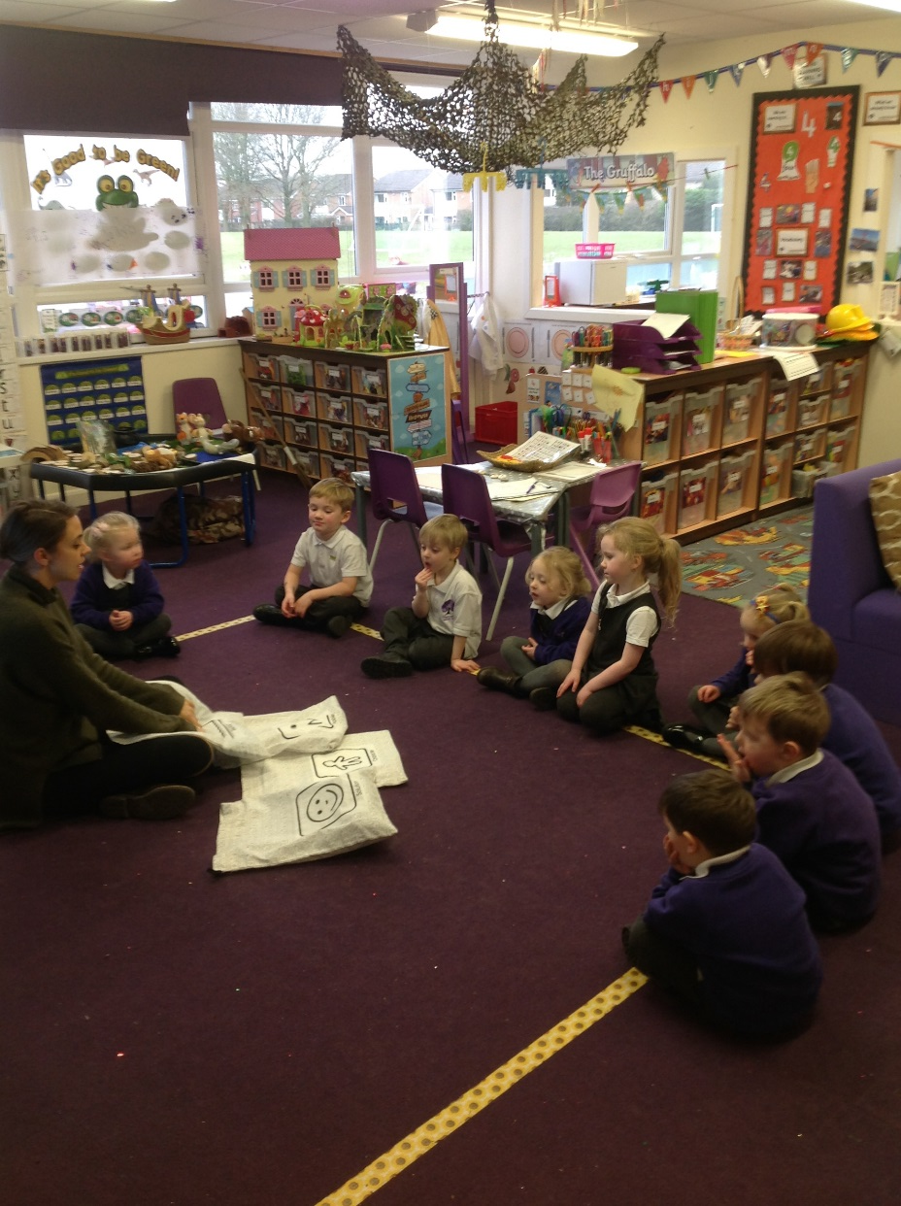
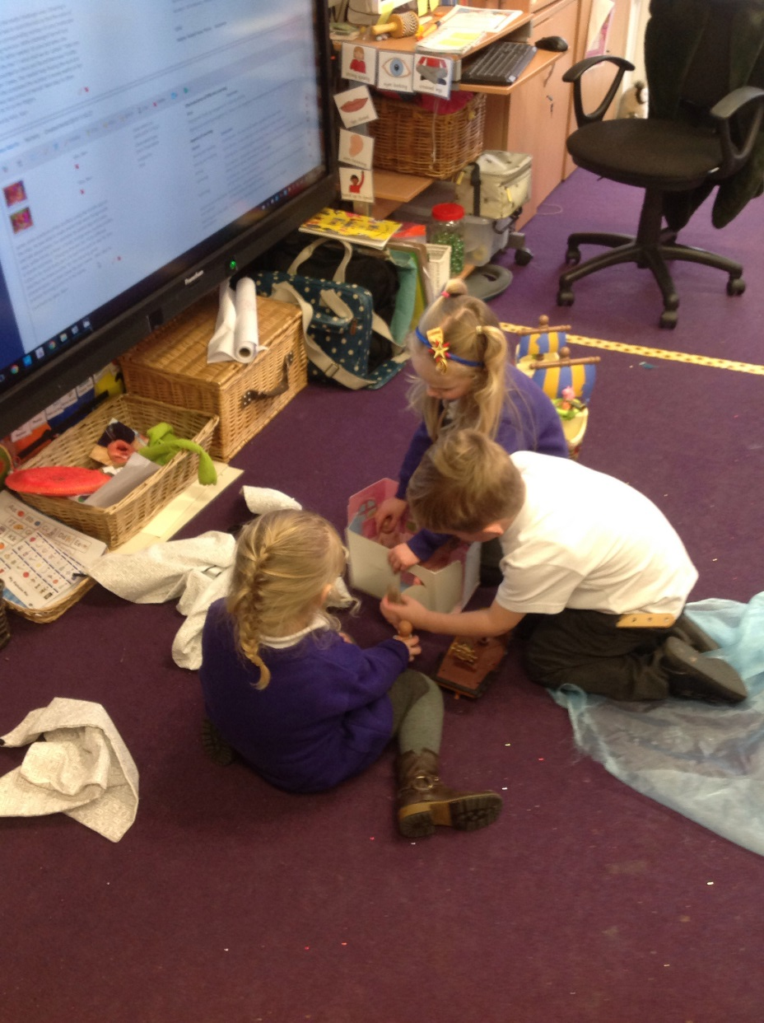
Circle time to share stories
Notes:
Sometimes we choose what goes in and sometimes the children choose, can get some very interesting outcomes and even if we have an idea of where we want the story to lead when we choose the items, usually leads somewhere completely different.

Slide 18
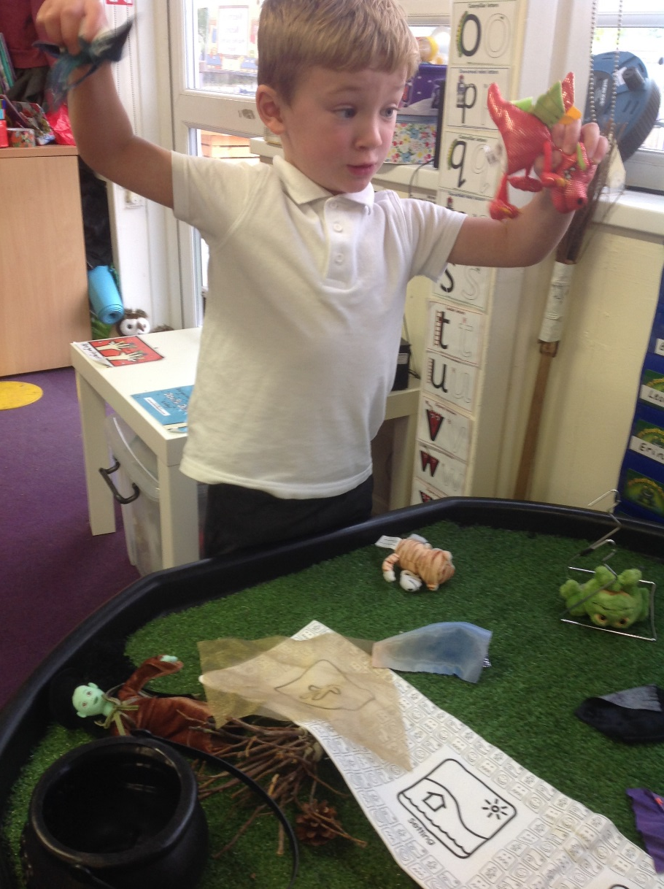
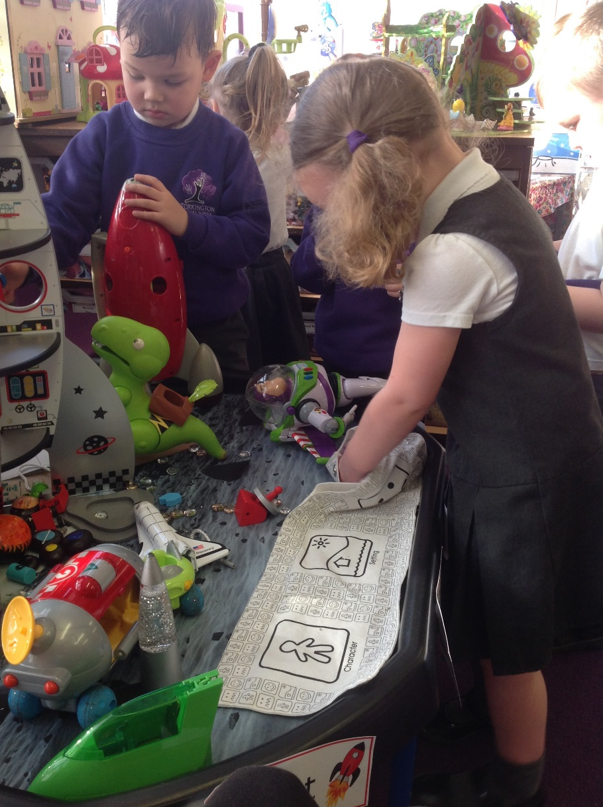
Choosing in the areas

Slide 19
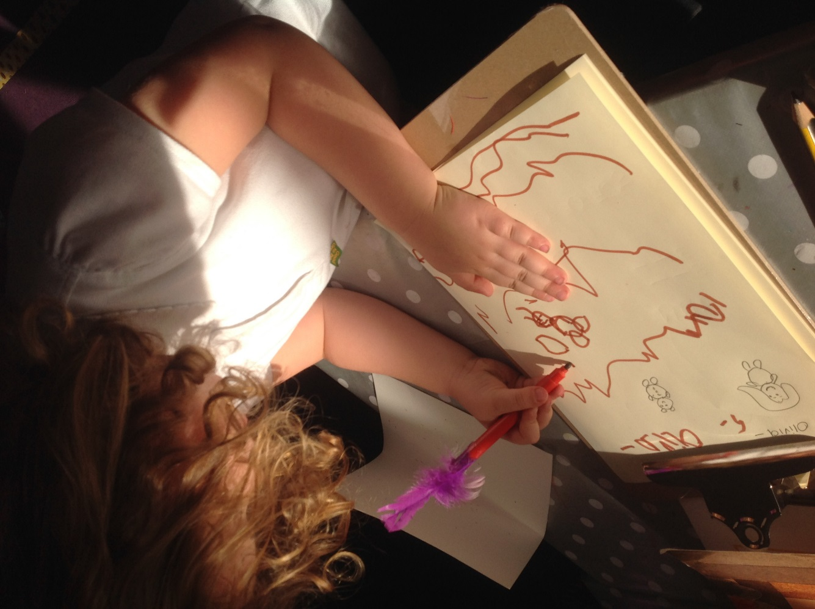
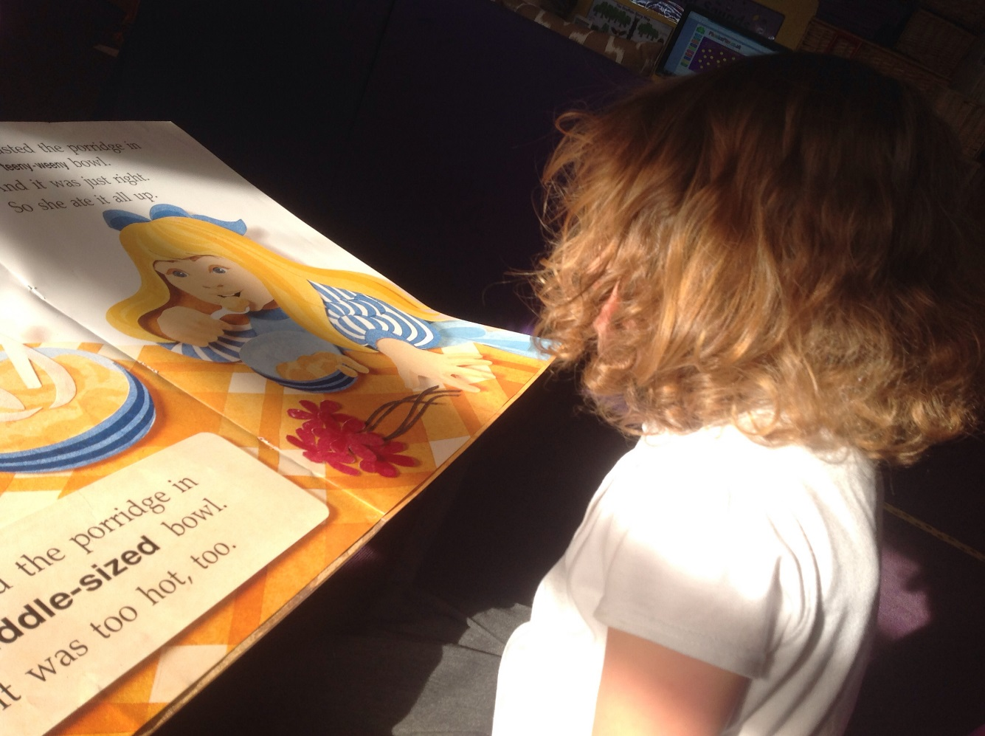
Recording stories

Slide 20
How we record children’s ideas

Slide 21
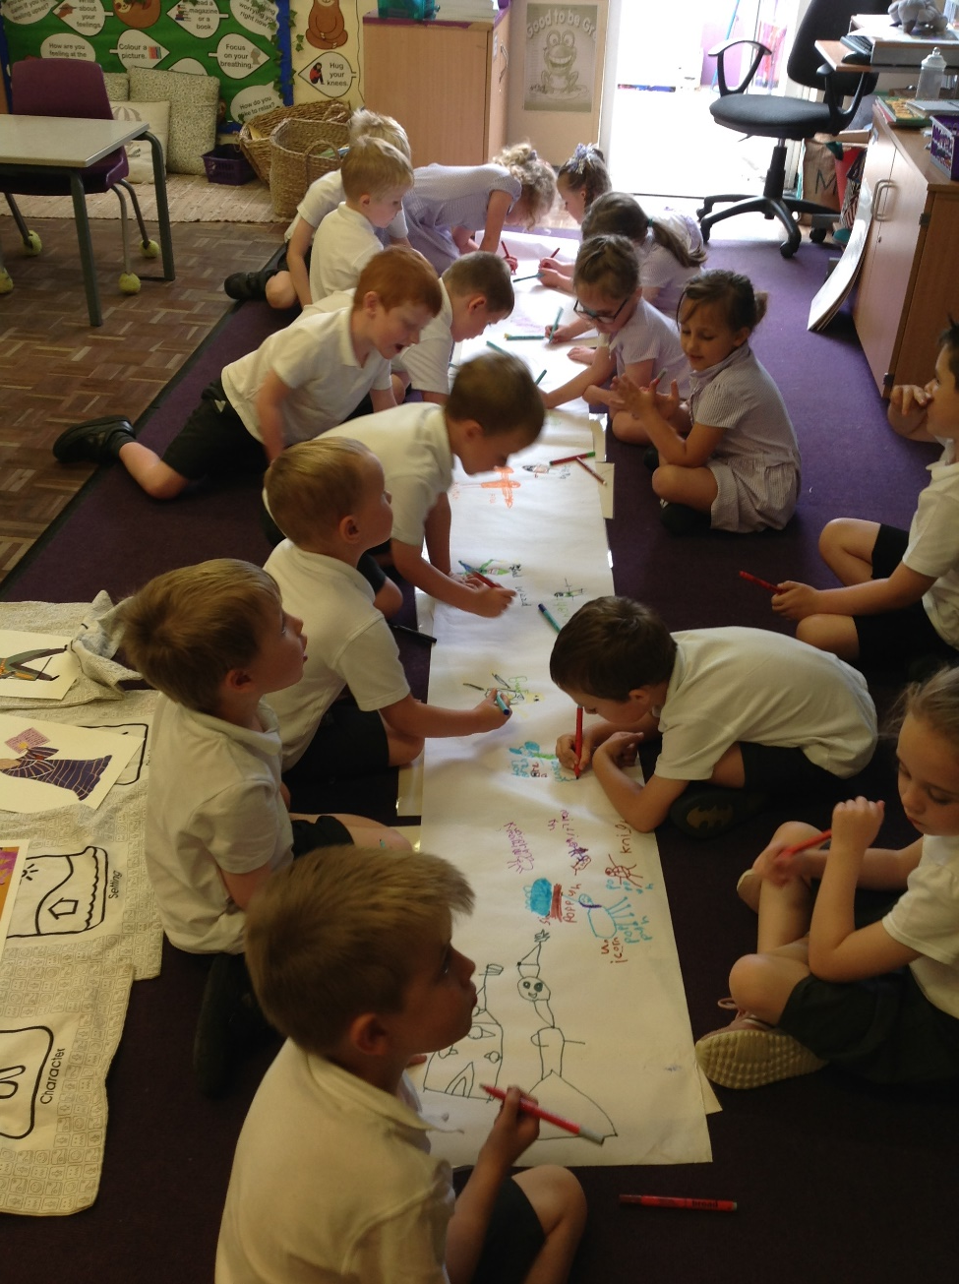
Circle time as a group
Used to create stories with large shared mark-making using rolls of paper on the floor. Laminated symbols are added to messy mark-making, creating stories in foam, paint, clay, or in chalk on the floor outdoors.

Slide 22
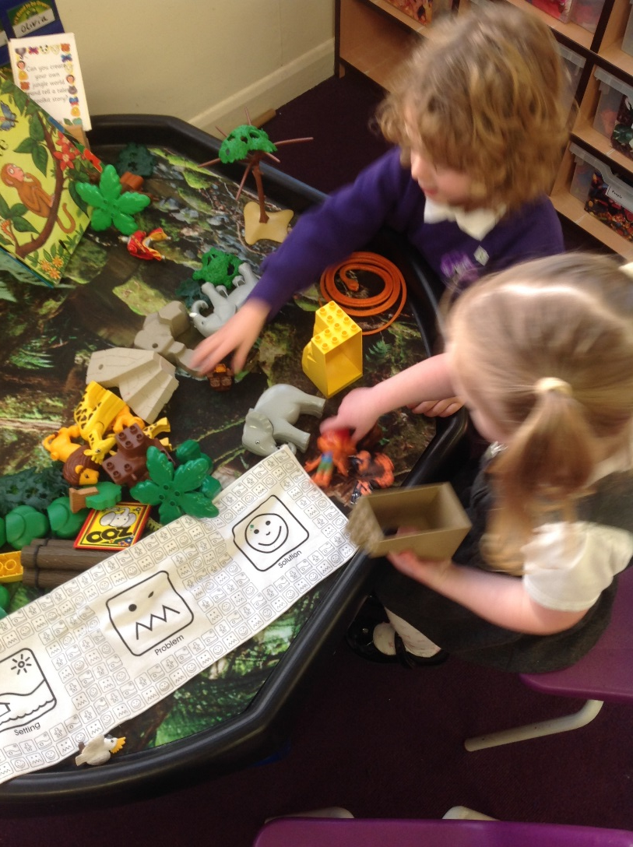
On the ipad as a video or a teacher scribing the child’s story
Children do not have to be able to write or even draw to make their own stories, often we will listen at the small world table to children telling their magical tales together and capture this on the ipad or scribe it for them. They love watching and listening to their stories and especially sharing them with their friends on the big screen!

Slide 23
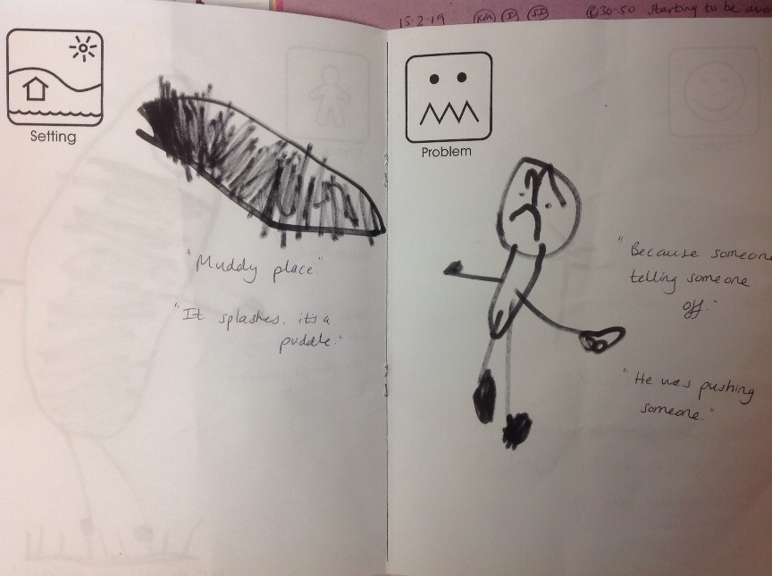
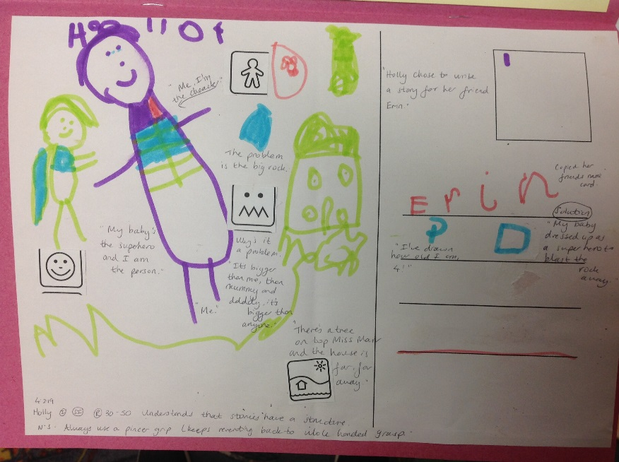
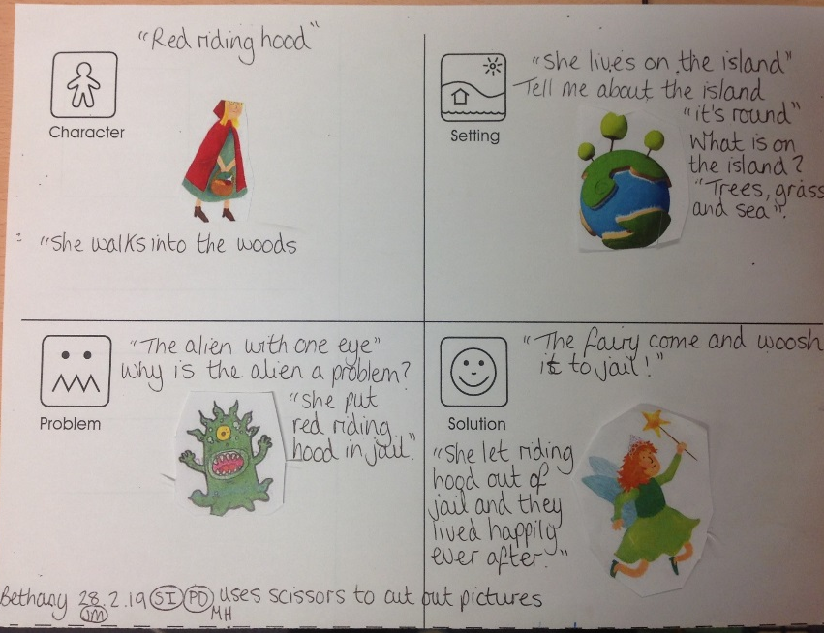
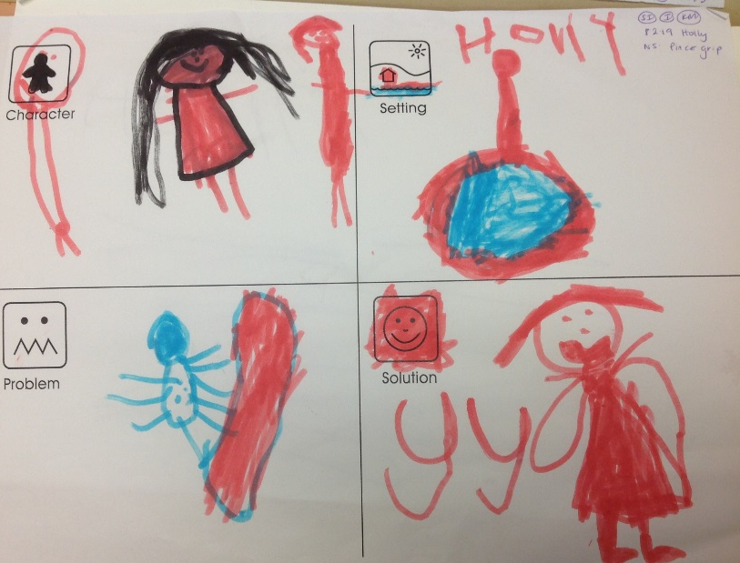
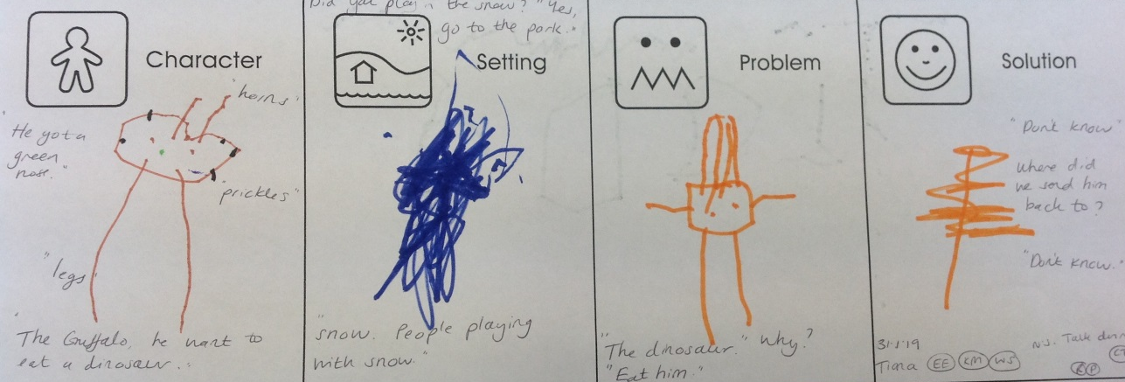
On tales toolkit worksheets in nursery
Notes:
Cut and stick pictures - Popular culture characters • Photos of themselves, friends, family members. • Settings the children will recognise from the local area • Famous and fantasy settings – Castles, Taj Mahal, The London Eye • Postcards from holidays • Characters from well known stories

Slide 24
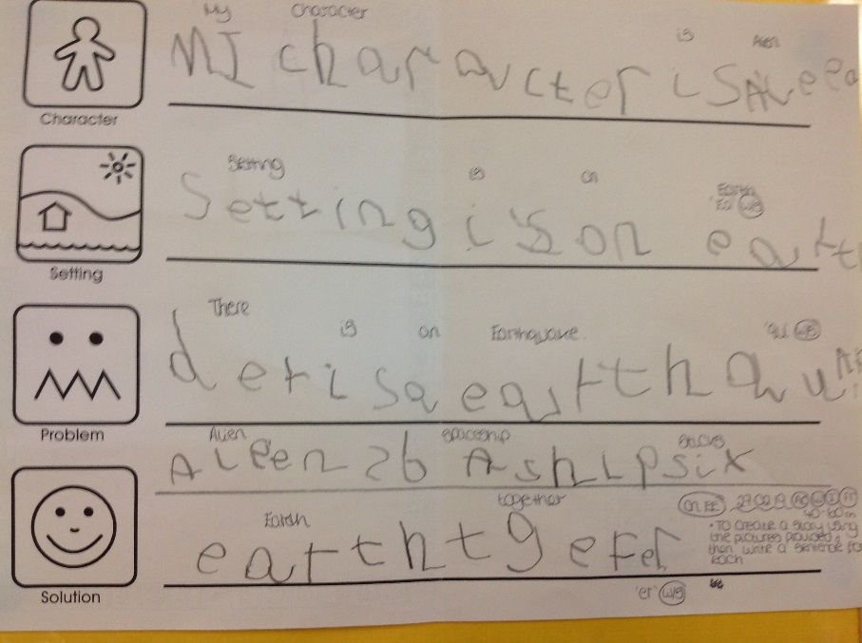
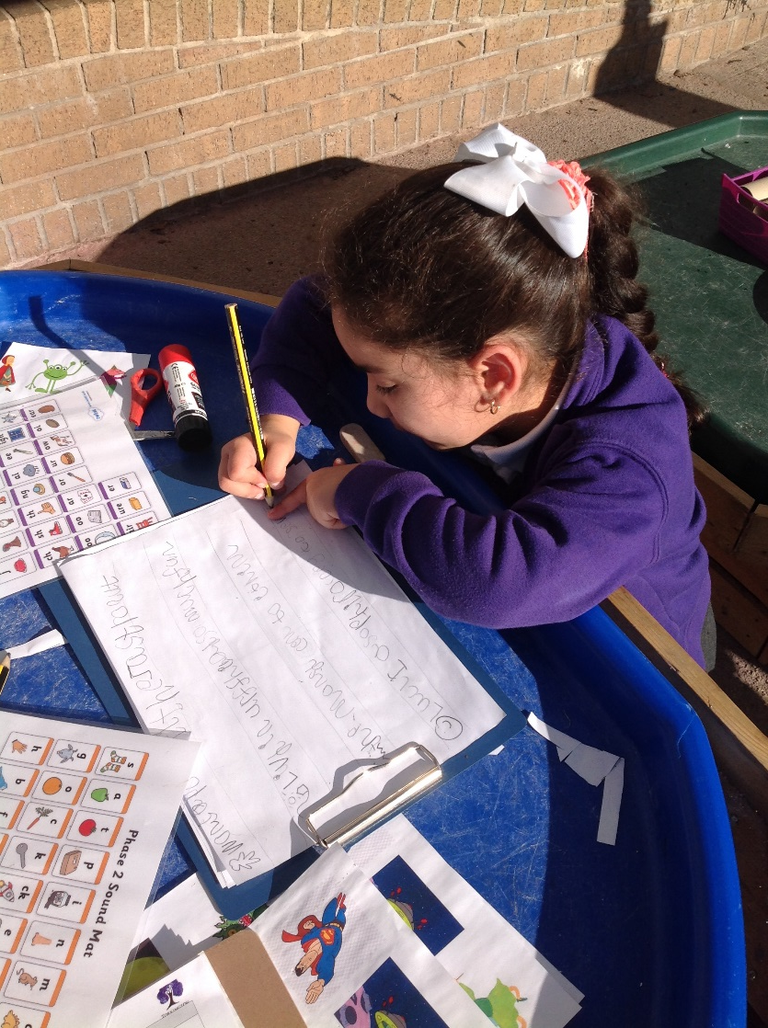
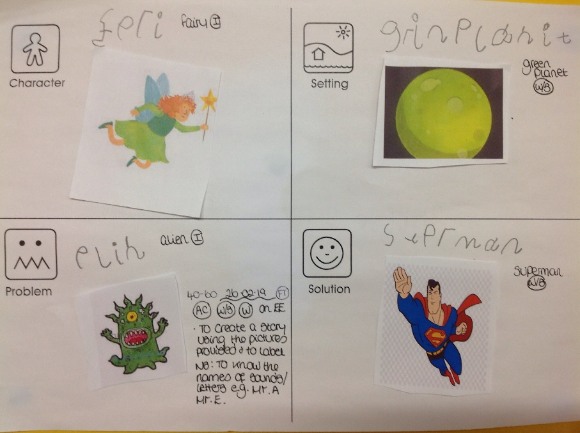
On tales toolkit worksheets in reception

Slide 25
On tales toolkit worksheets in reception
As part of our immersion experience for Year 1 on our transition days in July we collaborated to tell a tales toolkit story together. The children then used some of the cutting sheets to record and write their own stories. I will now share with you a couple of amazing examples!

Slide 26
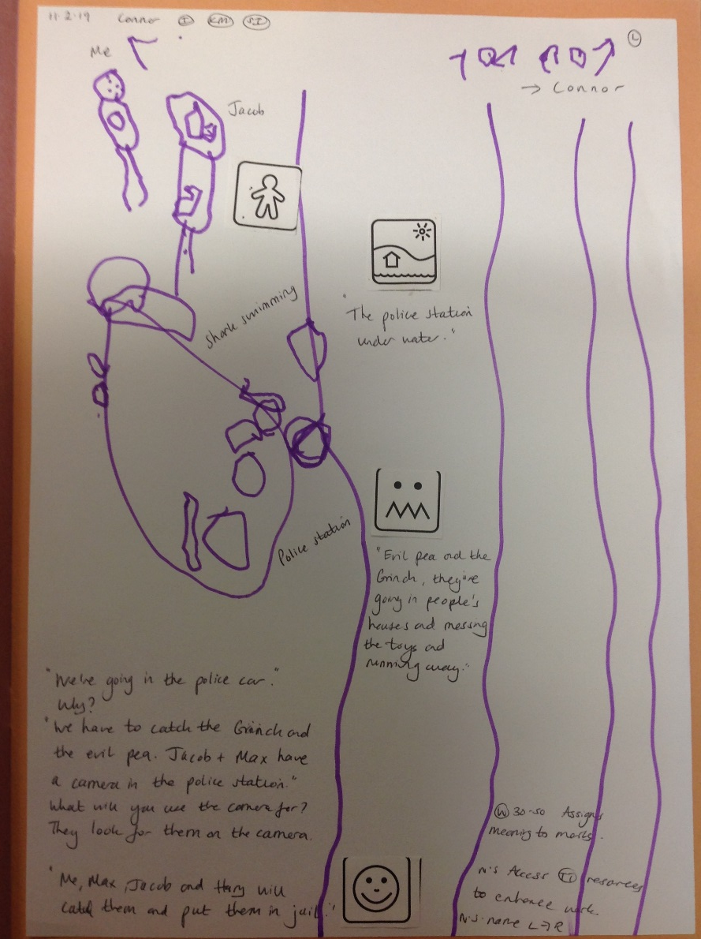
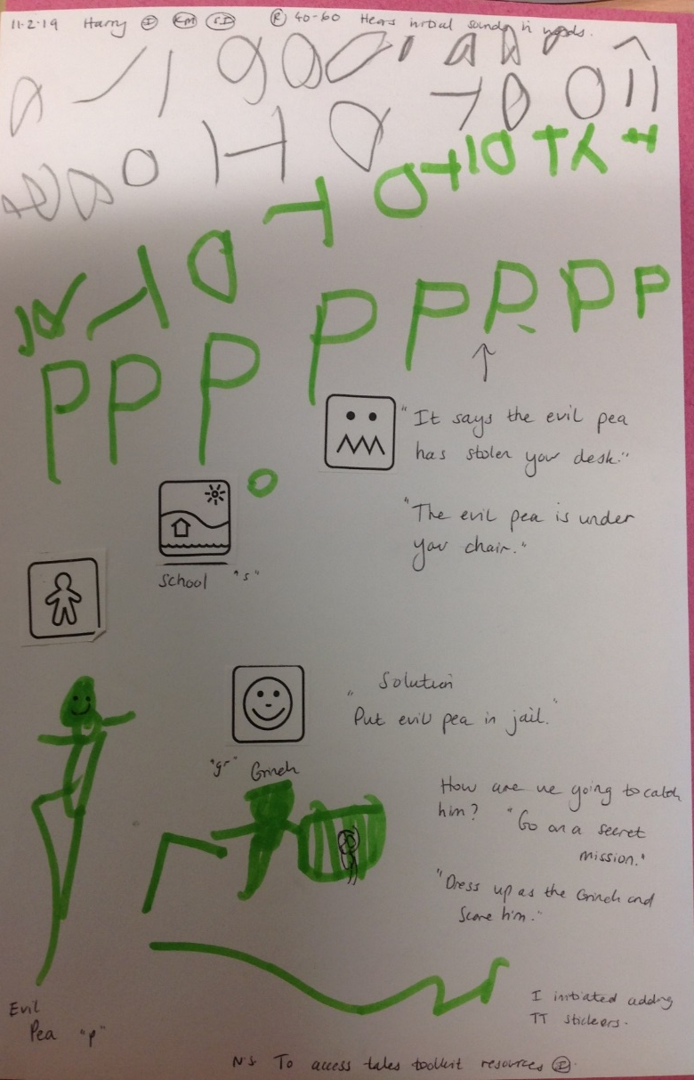
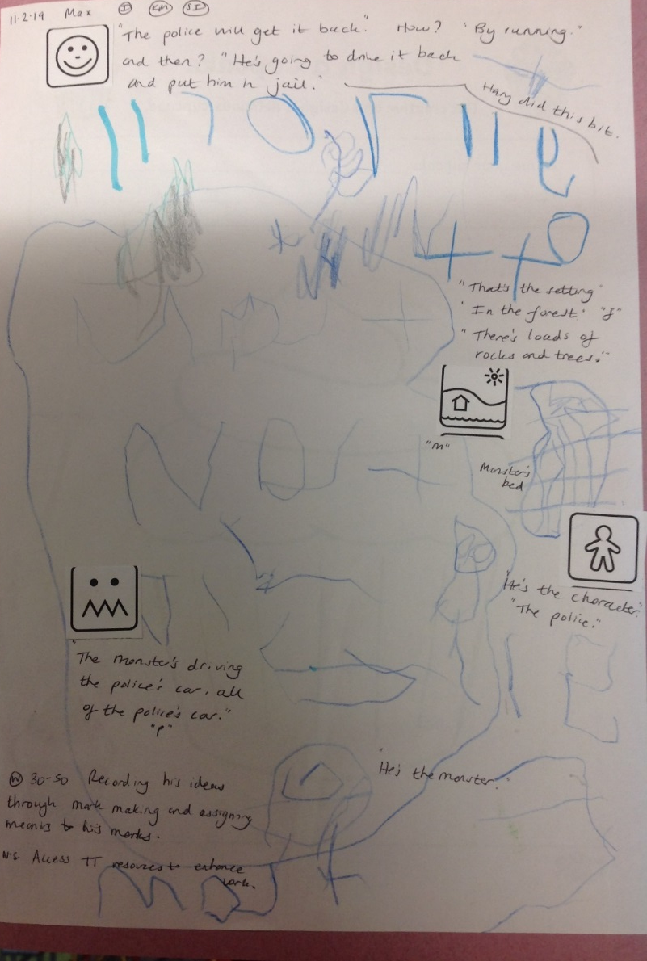
Using tales toolkit tabs
Notes:
Symbols added to children’s drawings to tell a story

Slide 27
Now let’s see it in action from children in our YEAR 1 class!

Slide 28
Thank you for coming, if you have any questions we will be happy to answer them now ☺

