Slide 1
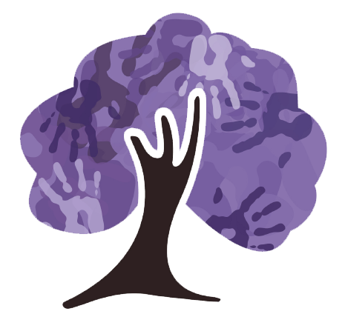
Science at Torkington
Primary School

Slide 2
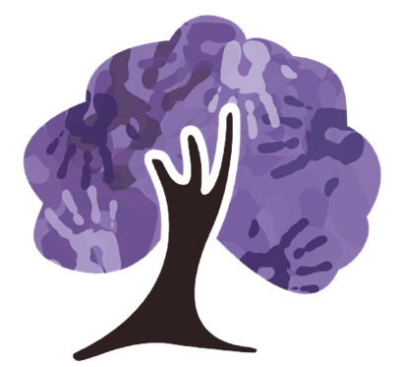
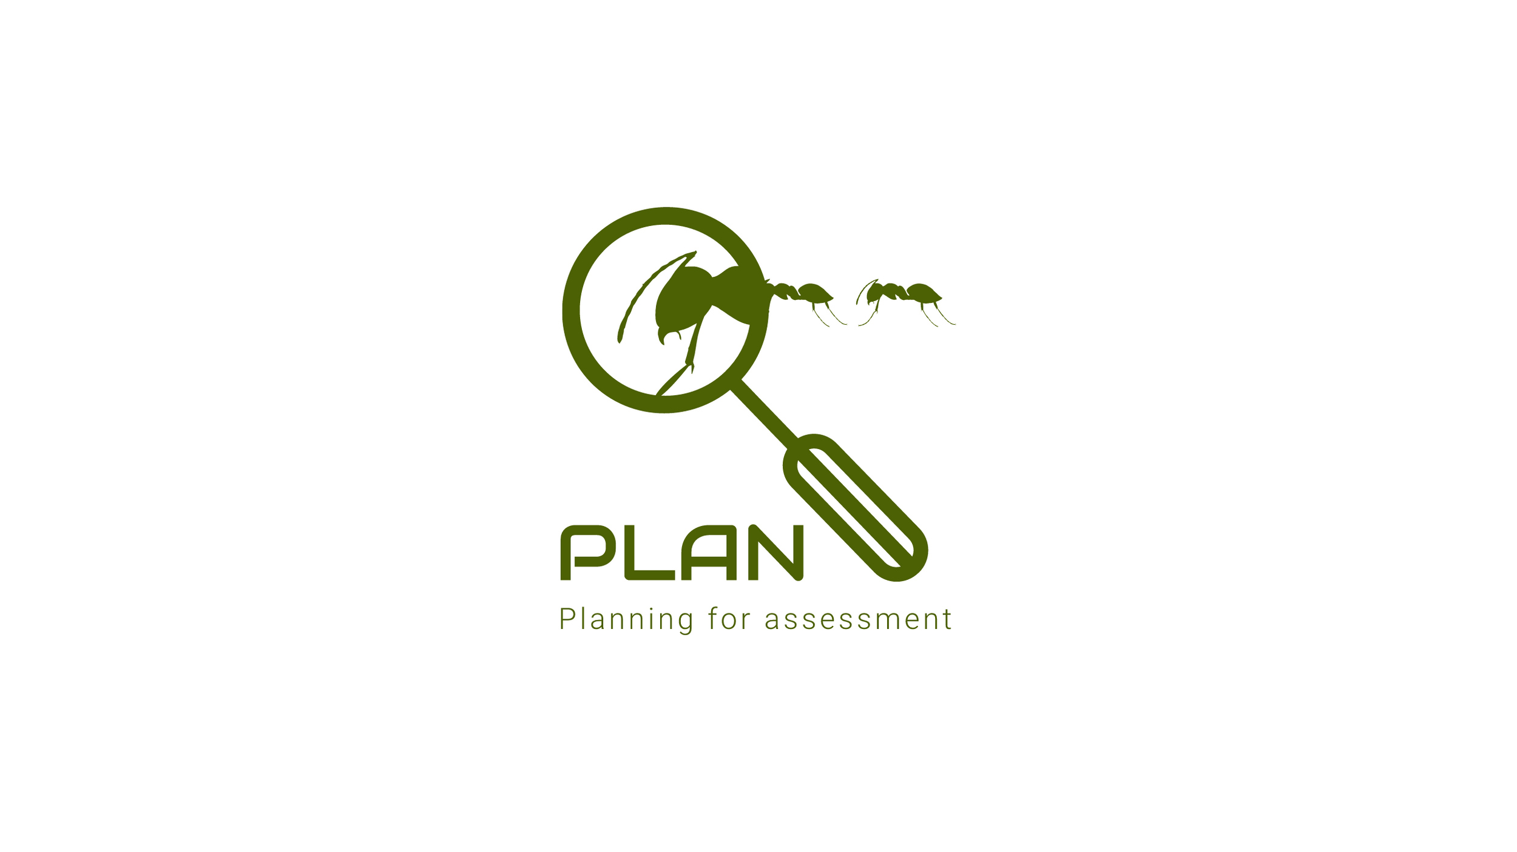
INTENT
At Torkington Primary School, the intent for Science is clear and ambitious: to move children from “doing” science to becoming scientists — curious, questioning, evidence-driven learners who understand the world around them and know how to investigate it.
Working Scientifically is the thread that runs through everything, from Nursery to Year 6 — not a bolt-on, but the foundation of how science is taught and experienced across the school. PlanAssessment provides the map that ensures full National Curriculum coverage and makes knowledge and skill progression explicit across year groups. PlanBee provides the lesson-level structure, with teacher autonomy built in for confident practitioners ready to go further.
Vocabulary, prior knowledge and misconceptions are taken seriously at every stage. Children are expected to use scientific language accurately and independently, to build on what they already know, and to have their thinking challenged and deepened. Science at Torkington is designed to feel like genuine enquiry — active, purposeful and ambitious for every child.

Slide 3


IMPLEMENTATION
In EYFS, science is woven into everyday experience. Rather than being taught as a discrete subject, scientific thinking is developed through continuous provision, enhanced play and hands-on exploration. Children are encouraged to look at the world around them with curiosity — observing, questioning and making sense of what they find.
The skills developed in EYFS — observation, problem solving, prediction and teamwork — are the same skills that underpin Working Scientifically throughout the rest of a child’s time at Torkington. Targeted questioning from staff is used to deepen thinking, and new vocabulary is introduced, modelled and revisited consistently so that children begin to build a scientific language to carry into KS1.
Planned practical science activities run throughout the year alongside the enhanced provision, giving children structured opportunities to explore, investigate and record their thinking. Children in EYFS respond with particular enthusiasm to hands-on experiments, and this is reflected in how the science offer in the early years is planned. The science lead works closely with EYFS staff to ensure curriculum coherence and a strong transition into Year 1.
In KS1 and KS2, science is taught as a weekly lesson, structured around PlanBee as the curriculum spine. PlanAssessment provides the base map — ensuring full National Curriculum coverage, informing planning, and making knowledge and skill progression explicit across year groups. Where PlanBee provides the lesson-level scaffold, PlanAssessment ensures that the broader picture — what children need to know, understand and be able to do — is always in view.
Planning draws on PlanBee as its primary resource, supplemented by elements from Oak Academy and Twinkl where appropriate. Teacher autonomy is a deliberate feature of the approach — confident practitioners are encouraged to move beyond the scheme where PlanAssessment outcomes are still being met. The direction of travel is clear: away from predominantly worksheet-based delivery and towards practical, investigation-led sessions in which Working Scientifically skills are developed alongside substantive knowledge. This shift is underway and is reflected in planning and lesson delivery across the school.
Teacher Assessment in Primary Science (TAPS) is used to develop investigative and Working Scientifically skills in a structured, purposeful way, ensuring children are not just learning about science but actively doing it. Explorify/vocabulary refresher starter activities are used consistently across year groups to activate prior knowledge, surface misconceptions and develop scientific discussion.

Slide 4
Knowledge and Skills prior to KS1
Children will ask questions about the environment including the weather outside. They will be able to suggest what they might wear.
They will develop an understanding of growth, decay and changes over time and show care and concern for living things and the
environment. They will use their senses when walking around and investigating. They will develop questioning and curiosity through play
and understand the concept of forces and electricity through twisting, pushing, slotting and magnetic toys and seeing the effects of
pushing different buttons to make sounds and movements. They can talk about similarities and differences between living things and
materials and make simple observations about animals.
Natural world
Explore the world around them making observations and drawings of plants.
Natural world
Know some similarities and differences between the natural world around them and contrasting environments, drawing on their
experiences and what has been read in class.
Communication and language- express their ideas and feelings about their experiences using full sentences.
The Natural World
Explore the natural world around them, making observations and drawing pictures of animals.
Begin to make sense of their own life-story and family’s history.
Begin to understand the key features of the lifecycle of a plant and animal.
People, culture and communities
Describe their immediate environment using knowledge from observation, discussion, stories and non-fiction texts and maps.

Slide 5
Knowledge and Skills prior to KS1
Personal, social and emotional development
Manage their own basic hygiene and personal needs, including dressing, going to the toilet and understanding the importance of healthyfood choices.
People, culture and communities
Explain some similarities and differences between life in this country and life in other countries, drawing on knowledge from stories,non-fiction texts and maps.
Understanding the world
Begin to understand the need to respect and care for the natural environment and all living things.
Explore the natural world around them
The Natural World
Understand some important processes and changes in the natural world around them, including changing states of matter.
Speaking
Offer explanations for why things happen, making use of recently introduced vocabulary from stories, non-fiction, rhymes and poems where appropriate.
Understanding of the world
Use all their senses in hands on exploration of natural materials.
Explore collections of materials with similar and/or different properties.
Talk about what they see using a wide vocabulary.
Explore how things work.Talk about the difference between materials and changes they notice.
The Natural World
Understand some important processes and changes in the natural world around them, including seasons.

Slide 6
Knowledge and Skills prior to KS1
Understanding of the world
Explore materials with different properties.
Talk about what they see, using a wide vocabulary.
Expressive arts and design
Safely use and explore a variety of materials, tools and techniques, experimenting with colour, design, texture form and function.
Explore colour and colour-mixing.
Understanding the World.
Explore and talk about different forces they can feel.
Can talk about the differences between materials and changes they notice.
Shows skills in making toys work by pressing parts or lifting flaps to achieve effects such as sound, movement or new images.
The characteristics of effective learning are the foundations on which working scientifically skills are build in KS1. While children are
playing and exploring, teachers should be modelling, encourahomg amd supporting them to do the following:
- Show curiosity and ask questions
- Make observations using their senses and simple equipment
- Make direct comparisons
- Use equipment to measure
- Record their observations by drawing, taking photographs, using sorting rings or boxes and in reception on simple tick sheets
- Use their observations to help them to answer their questions
- Talk about what they are doing and have found out
- Identify, sort and group

Slide 7
Assessment
Science assessment at Torkington is undergoing a deliberate, managed transition — moving away from end-of-unit tests as the primary measure and towards embedded, formative assessment that captures understanding as it develops. This does not reduce assessment rigour; it relocates it into the everyday substance of teaching. The aim is for assessment to be continuous, responsive and directly connected to what children demonstrate they know and can do.
PlanAssessment is central to this approach. It provides clearly mapped assessment opportunities within each unit, flags likely misconceptions, identifies prior learning connections, and suggests specific moments within lessons where understanding can be gauged. The science lead has delivered INSET to introduce PlanAssessment Knowledge Matrices to all staff, and building confidence in its formative tools is an active and ongoing priority. This is a staged implementation — purposefully phased to ensure it becomes embedded practice rather than an additional layer.
In EYFS, scientific skills and knowledge are assessed through observations, practical work and curriculum tracker evidence, with the science lead working closely with EYFS staff to ensure coherence and progression into KS1. Across all year groups, the goal is consistent: assessment that informs teaching in the moment, builds a picture of progress over time, and ensures no misconception goes unchallenged.

Slide 8
How does the science curriculum take account of the needs of all pupils, including your most disadvantaged and SEND pupils?
Science at Torkington is designed to be genuinely accessible for all learners. Differentiation is built into how science is planned and delivered — through the activities chosen, the support provided, and the resources used. Children are given the opportunity to demonstrate their understanding in a variety of ways, ensuring that lower attainment in writing does not become a barrier to demonstrating genuine scientific thinking.
In lessons, teaching staff identify children who need additional support and those who need an extra challenge, responding in the moment rather than relying solely on pre-planned tasks. TA support in science is deployed to enable access and build independence, rather than to remove challenge — preserving the productive struggle that underpins genuine understanding.
Explorify is used regularly across the school as a starter tool that caters for a range of learning styles and entry points. Its visual, discussion-based approach enables all children to access and contribute to scientific thinking from the start of a lesson — including those with SEND, EAL, or who are disadvantaged. The progressive structure of the curriculum ensures that every child is building towards clearly defined next steps in their scientific understanding.

Slide 9
IMPACT
Children in EYFS demonstrate genuine enthusiasm for science. Practical, hands-on experiments and exploratory activities are among the most positively received elements of provision, evidenced through observations and curriculum tracker records. As children progress through Nursery and Reception, their ability to observe, question and begin to explain what they notice develops in a visible and meaningful way.
Vocabulary acquisition is supported by consistent modelling and repetition from teaching staff, and children increasingly adopt and use new scientific language with confidence. Independent working skills grow across the year, and children develop a disposition of curiosity — a desire to keep asking questions rather than accepting a first answer. This is the foundation of scientific thinking, and it is the starting point from which the science curriculum builds as children move into KS1 and beyond.
Children across KS1 and KS2 enjoy science and engage with it well. Lessons are increasingly practical and investigation-led, with children actively doing science rather than passively receiving it. In KS2 particularly, children are developing the ability to talk through their investigations with growing confidence — explaining what they were trying to find out, what they did, and what they think their results mean. This is the scientific identity our Intent describes, and it is beginning to be visible in how children approach and discuss their learning.
Staff voice data shows curriculum engagement rated consistently positively across all year groups (average 4.2/5), with assessment confidence also strong (average 4.0/5). Vocabulary is an identified development area (average 3.6/5 confidence), and this is being addressed proactively through the development of a shared vocabulary framework mapped to each year group and unit. This is not a gap that has been left unmanaged — it is a clearly evidenced priority with a defined plan.
A diagnostic audit — comprising staff voice, pupil voice, book look and lesson observations — has been proactively commissioned by the science lead this term to build a rigorous, evidence-based picture of science across the school. This work is not reactive: it is the foundation of a deliberate, planned improvement cycle. Phase 2 will use these findings to refine and strengthen the curriculum, with PlanAssessment providing greater consistency in knowledge progression and formative assessment practice across all year groups.

