Slide 1

PE at Torkington
Primary School

Slide 2

INTENT
At Torkington Primary School, we believe that Physical Education is a core part of every child’s education. PE develops not only physical capability, but also confidence, resilience, collaboration, and the knowledge to understand and look after one’s own body and mind.
Our intent is to deliver a curriculum that goes beyond physical activity — one that provides genuine physical education. We want children to understand what they are learning, why it matters, and how their skills develop and connect across year groups. Every child, from Nursery to Year 6, should leave Torkington with the competence and confidence to engage in a wide range of physical activities throughout their lives.
Our curriculum is built around the aims of the National Curriculum and has been designed in collaboration with our external partner Kickstart and informed by direct conversations with feeder high schools — ensuring children arrive at Year 7 with the skills, knowledge and attitudes required to thrive in secondary PE. We seek opportunities for children to engage in competitive sport, develop as team members, and take responsibility for their own health and fitness.

Slide 3



IMPLEMENTATION
As well as being taught as an area in its own right, Physical Education is incorporated across a variety of other curriculum areas, through enriching activities and after-school clubs.

Slide 4

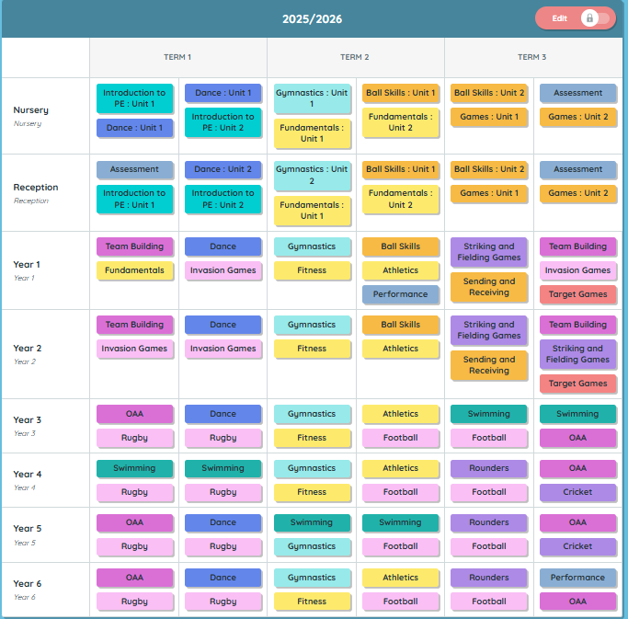
Whole School PE Progression
IMPLEMENTATION
In collaboration with Kickstart Sports and LifeLeisure Hazel Grove, pupils from Nursery to Year 6 take part in two one-hour PE sessions per week. The curriculum has been significantly redesigned at the start of the 2025/26 academic year — built backwards from Year 6 to Reception, informed by direct conversations with feeder high schools who identified specific skill gaps at transition.
A key feature of the redesigned curriculum is depth over breadth: fewer sports are covered per term, but each sport is spread across a full term to allow children to revisit and embed key skills. For example, rugby is delivered across the entirety of the Autumn term in Years 3–6. Sports are revisited at the same point each year to support long-term recall and progressive skill development.
Tag rugby and Outdoor and Adventurous Activities (OAA) have been added to the curriculum following transition gap analysis. The curriculum is fully mapped across all year groups from EYFS to Year 6, ensuring consistent coverage and progression.

Slide 5

Get Set 4 PE
GetSet4PE is the adopted curriculum scheme for PE at Torkington, providing a structured, progressive framework for teacher-led delivery across all year groups. The scheme supports staff in delivering high-quality lessons with clear learning objectives, differentiated activities, and explicit skill progression from EYFS to Year 6.
The current curriculum was redesigned in collaboration with Luke from Kickstart at the start of the 2025/26 academic year. The redesign was informed by direct conversations with feeder high school PE staff, ensuring children develop the foundational skills required for secondary PE from the earliest stage. The longer unit structure — with sports spread across a full term rather than a half term — was a deliberate design decision to allow depth of learning and revisiting of key skills.
As part of staff CPD, Kickstart delivered training on the STEP principle (Space, Task, Equipment, People), supporting teachers to adapt and differentiate PE activities effectively. Staff confidence in delivering GetSet4PE across all units is high, and the planning is consistently described as accessible, adaptable, and well-suited to the range of learners in each class.

Slide 6
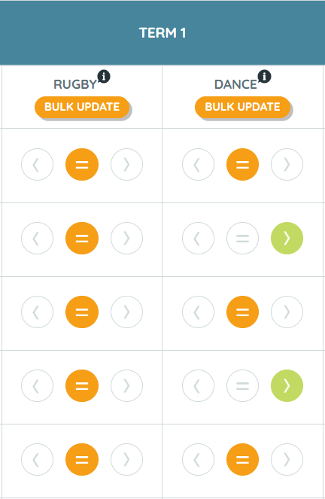

Whole School PE Progression
IMPLEMENTATION
PE assessment at Torkington is now fully embedded within the GetSet4PE online assessment system. Each sport has a set of clearly defined learning objectives, aligned to GetSet4PE assessment criteria and confirmed by Kickstart coaches to ensure lesson content matches the assessed skills.
Children are assessed against these skills by sports coaches and class teachers, with the online system enabling tracking of individual progress year on year. This provides a clear and meaningful picture of skill development across a child’s time at Torkington.
Staff voice has consistently highlighted the system as straightforward to use, with skills that are clear and easy to understand. The shift to online assessment has significantly improved the clarity and consistency of PE assessment across the school.
Swimming
Swimming is delivered to Years 3, 4 and 5, with each year group completing one full term of swimming lessons at Hazel Grove Leisure Centre (LifeLeisure). In line with the redesigned curriculum map, Year 4 swims in Term 1, Year 5 in Term 2, and Year 3 in Term 3.
Sessions are led by a qualified swimming teacher. Class teachers are allocated a higher ability group following initial assessment, and are provided with a lesson plan at the start of each session. Key skills are demonstrated by the swimming teacher throughout.
Teaching assistants are deployed to support lower-ability swimmers, either in the shallow end or small pool as required. Children are assessed against the National Curriculum aim of swimming 25 metres confidently using a variety of strokes.

Slide 7
Competitions and Sports Day
IMPLEMENTATION
The school football team competes in local area fixtures and leagues, providing children with regular experience of competitive sport and representing their school. There is an ambition to broaden competitive opportunities further — including intra-school competitions and inter-school festivals across a wider range of sports — and this will be developed in collaboration with Kickstart, informed by pupil voice findings.
Sports Day has been significantly revamped in recent years, developed in collaboration with Kickstart. The event now offers a broader range of activities to increase pupil engagement and ensure greater inclusivity. A staggered approach has been introduced to allow for full parental involvement and to create a less overwhelming experience for children.
Events on Sports Day are actively supported by teaching in lesson time, ensuring children arrive prepared and confident. After-school clubs led by Kickstart also contribute to Sports Day content (e.g. archery), giving children additional opportunities to develop and showcase their skills in a competitive but supportive environment.

Slide 8
Knowledge and Skills prior to KS1
IMPLEMENTATION
Physical development in the Early years is a Prime area of learning and as such is evident across all our provision, both indoors and outdoors. All staff are aware that throughout children's physical development, gross and fine motor experiences develop incrementally and our provision is planned to cater for this. It starts with sensory explorations and the development of a child's strength and coordination and builds as they gain more control. The EYFS Physical development framework (2021) now focuses on moving and handling and has designated separate goals for the development of gross motor skills and fine motor skills. At Torkington, we believe strongly in the importance of developing these skills and giving children daily opportunities to gain strength and coordination that will build over time to aid writing.
Enabling children to refine their fine and gross motor skills promotes their independence and equips children with the skills they need to progress within the other areas of learning and development. Across the continuous provision there are always opportunities for the children to develop both fine and gross motor skills. For example, outside the children have large blocks to lift and transport, brushes varying in size that require a range of physical skills to control, scarves to dance with, chalk to mark make, jugs to pour etc. Inside the children always have access to dough, threading, scissors, mark making equipment etc. Staff also plan carefully for the children's next steps and provide activities to build on prior learning. By using a range of continuous provision and individualized learning adults can support children to develop their core strength, stability, balance, spatial awareness, coordination and agility. Being outdoors is essential in the early years and at Torkington this is given high priority. Children are given extended periods of time where they can be outdoors and have a range of resources they can access independently. Being outside gives the children freedom and autonomy to move in ways that may not be possible indoors, and gives children an opportunity to do things on a larger scale

Slide 9
IMPACT
PE at Torkington has a clear and positive impact on children across the school. Children are happy, confident, and actively engaged in a broad and ambitious curriculum that develops them not just as athletes, but as physically educated young people.
The shift to physical education — rather than simply physical activity — means children are developing knowledge and understanding alongside physical skills. They are increasingly able to talk about what they are learning, why it matters, and how their skills build year on year. This deeper understanding is a key measure of the curriculum’s impact.
Staff confidence in delivering PE is high across all key stages. Teaching staff deliver PE regularly and with clear subject knowledge, supported by strong CPD provision from Kickstart. Children respond well to the quality of teaching and are consistently well-engaged across all areas of the curriculum.
The redesigned curriculum — with its longer units and focus on revisiting key skills — is allowing children to develop genuine depth in their learning. Progressive skill development from EYFS to Year 6 ensures that children build on prior knowledge and arrive at each new stage well-prepared.
Participation levels are strong, with children regularly seen engaged and active in PE lessons. The range of sports on offer — including rugby, OAA, gymnastics, dance, swimming, football, rounders and cricket — ensures broad engagement and caters to a wide variety of interests and strengths.
Children take part in competitive opportunities including school football fixtures and leagues. The revamped Sports Day provides all children with the chance to perform, compete, and celebrate their achievements. We aspire for every child to leave Torkington with a love of sport and the confidence to remain physically active throughout their lives

Slide 10
IMPACT – PUPIL VOICE
Pupil voice is gathered regularly and used by the PE coordinator to inform curriculum decisions and future planning. The most recent pupil voice findings reflect a highly positive picture of engagement and enjoyment across all key stages.
Gymnastics is consistently highlighted as a favourite across EYFS and KS1, with children particularly enjoying equipment use and the opportunity to take safe, manageable risks. Football is a strong favourite in KS1 and KS2, and team sports more broadly are highly valued — with KS2 pupils specifically requesting more team-building opportunities. OAA is popular in KS2 for its collaborative, problem-solving focus.
Children express enthusiasm for trying new sports, including hockey, basketball and tennis. A recurring area for development is children’s ability to self-assess and articulate their own progress — a priority being addressed through curriculum development focused on deepening children’s understanding of physical education. A full pupil voice audit is planned for Summer 2 in collaboration with Kickstart.

