Slide 1


maths parent workshop

Slide 2
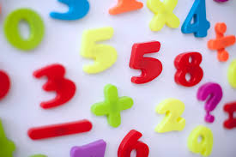
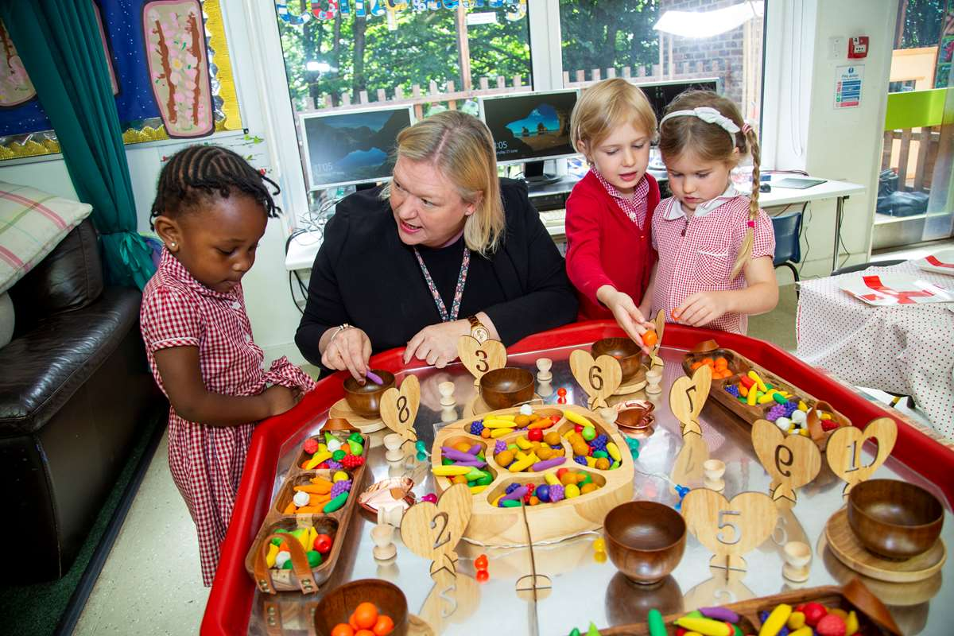


What is your earliest memory of maths?

Slide 3

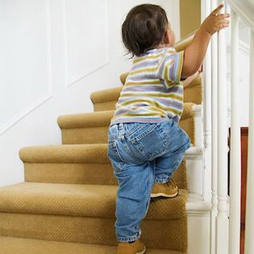

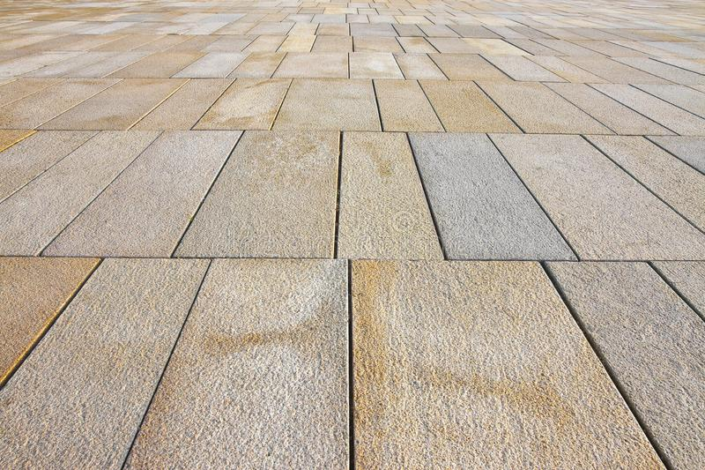
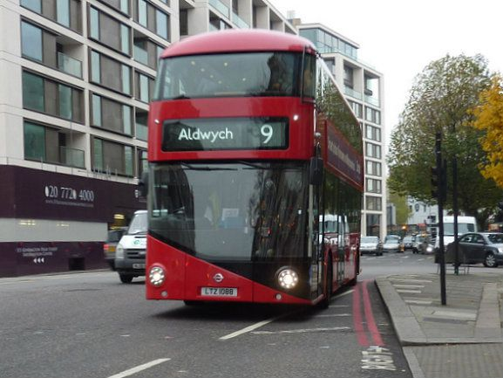

Maths is everywhere

Slide 4
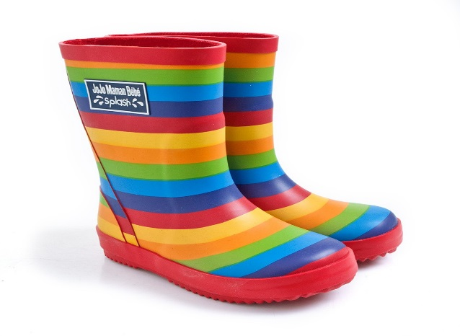
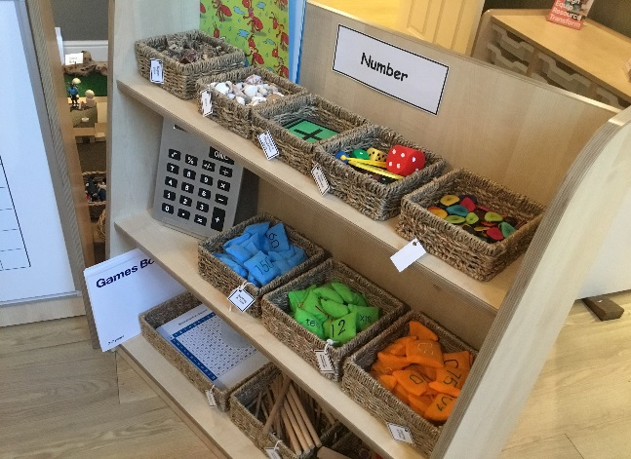
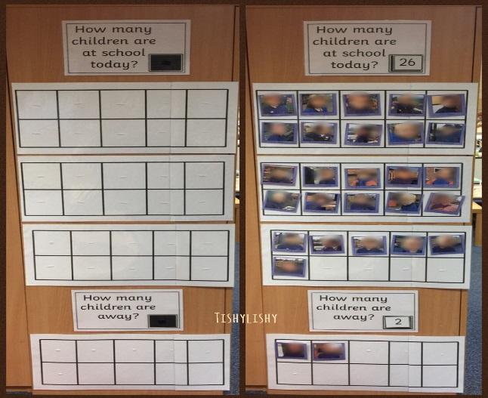
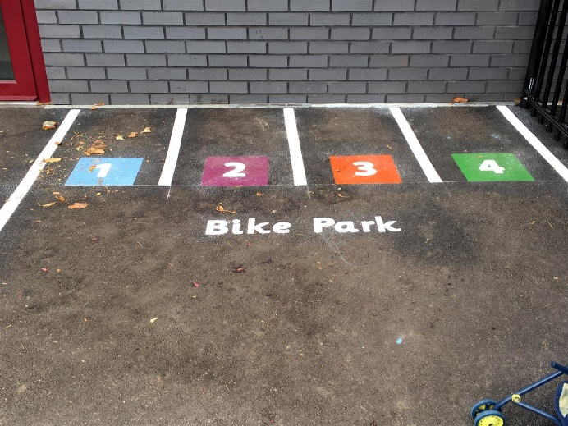
Developing number sense through:
ROUTINES

Slide 5
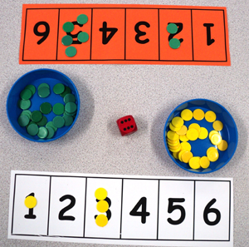
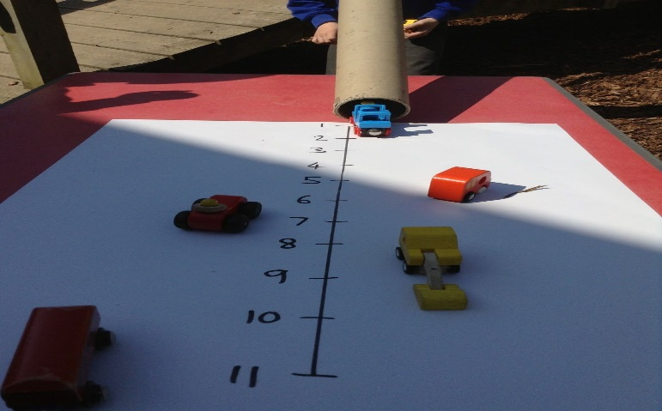
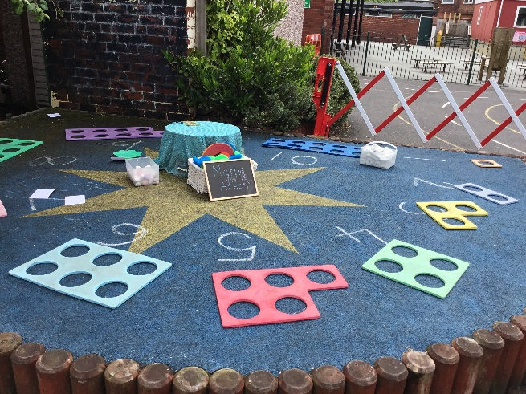
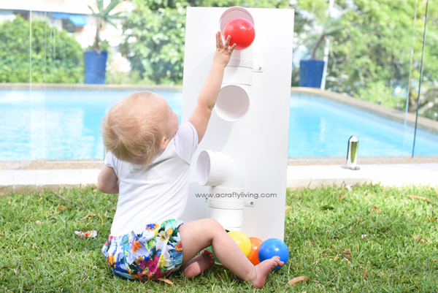
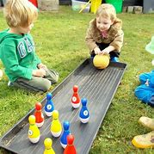
Developing number sense through:
GAMES

Slide 6

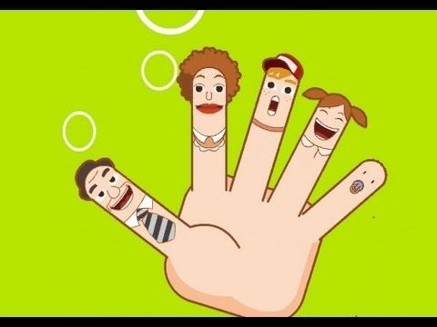


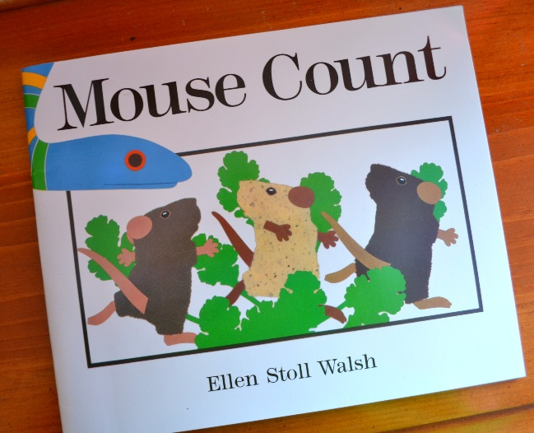

Developing number sense through:
RHYMES AND STORIES

Slide 7
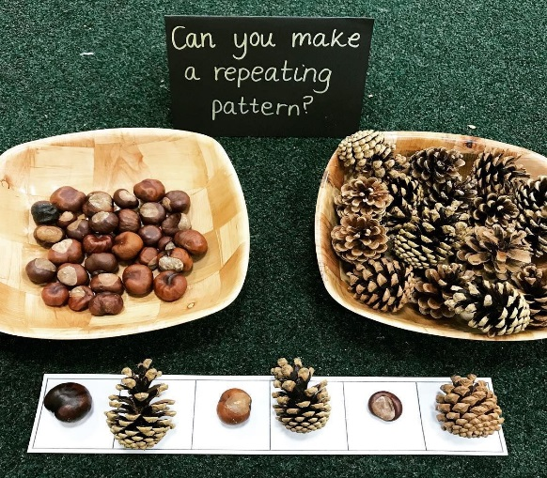
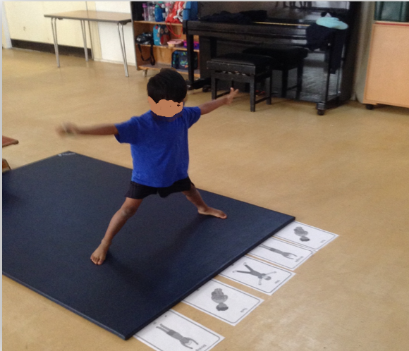
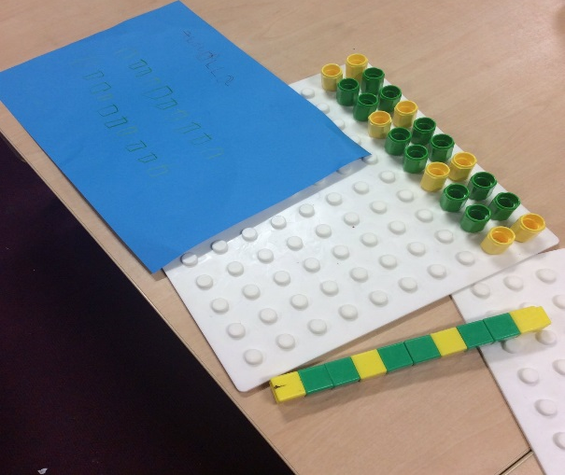
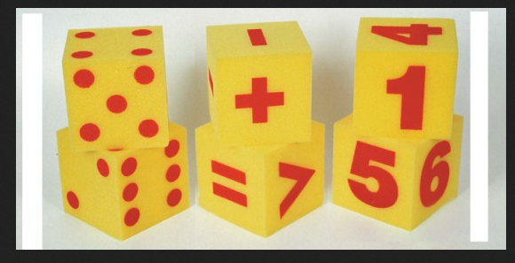
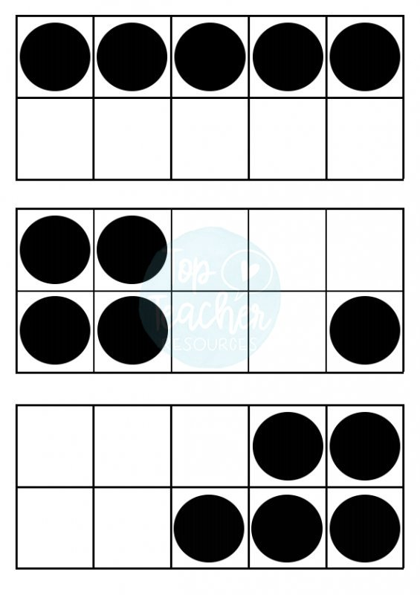
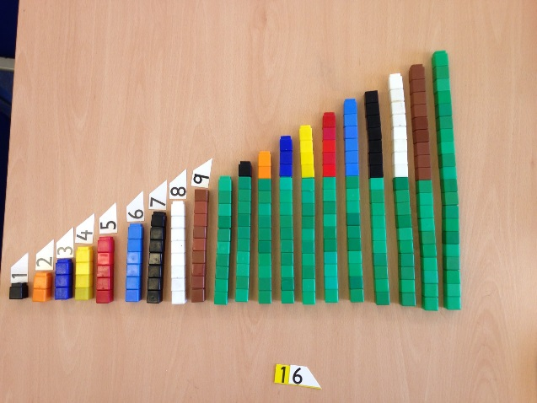
Developing number sense through:
PATTERN SPOTTING

Slide 8
What is our approach to maths?
A 2012 study by the Guardian showed that mathematical anxiety is believed to affect about a quarter of the population, which would equate to more than 2 million school children in England alone. This included children as young as six years old
We use a hybrid of Power Maths and Singapore maths to build students’ mathematical fluency without the need for rote learning.
It has a huge emphasis on problem solving and working together to share and explain our thinking. Being able to complete maths questions is only the first step, to be able to share their thinking and explain to others helps embed concepts and support children to truly master them.
Introduces new concepts using Bruner’s Concrete Pictorial Abstract (CPA) approach – further detail to follow.
Pupils learn to think mathematically as opposed to reciting formulas they don’t understand.

Slide 9
Why we choose power/singapore maths
It gives children the ability to think for themselves and encourages children to solve problems in different ways but first giving them the tools to experiment on their own. Challenges any ability by letting them choose their own way.
Encourages independent learning as well as co-operation and collaboration.
Allows for peer to peer learning.
No answer is ever wrong it’s just a step to reaching the right answer.
Children solve problems and learn from making their own mistakes. Just telling a child they are wrong and correcting them doesn’t help them learn, letting a child explore and discover mistakes using concrete objects is much more powerful and effective.

Slide 10
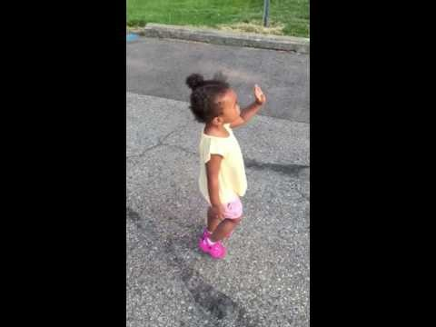
Children learn from being giving the chance to explore maths and mathematical experiences, not from being told the answer. https://www.youtube.com/watch?v=ZtUPKekDY7M

Slide 11
Predictors of Mathematical success in the Early Years
A large scale study of pre-school experiences (Sammons et al 2002, Siraj-Blatchford et al 2002) found two key factors which predict progress:
parents providing a home learning environment, where, for instance, children were encouraged to paint, draw and play with letters and numbers
pre-school settings providing adult-led mathematics focused activities, such as number rhymes and games, alongside independent play
Research also tells us that developing young children’s number sense is key to mathematical success. This includes understanding numbers and number relationships in order to solve mathematical problems.

Slide 12
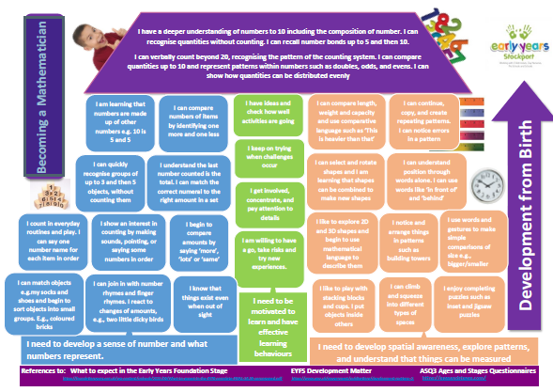

Slide 13
Lesson structure

Slide 14
Lesson sturcutre
Warm up – counting and number songs
Anchor/Explore – Hook question – children given a question to explore together/individually using concrete materials. Often asked to find more than one way to solve the problem. Answers are then shared as a group from a variety of children using the question stems to develop and extend their thinking and explanations. This is where the teaching happens in the model explanation.
ASK WHAT DID YOU DO? Not what was the answer.

Slide 15
Lesson structure
Focus Task – Children asked to solve new problems now they have all the necessary knowledge to enable them to do so.
Reflection – at the end of the session children put into their own words what they have learnt today.
Continuous provision – Children have the opportunity in their choosing time to consolidate their knowledge from this weeks teaching.

Slide 16
Independence and processing
Of the Anchor task Ban Har 2015 said “Children will never remember unless they have worked it out. The need to go through a figuring out process first. The need to use concrete materials and figuring out needs to be done sufficiently before they can remember. Children can not just be expected to recall.”
“You have to let them struggle through it, to help is to interfere with learning.” Ban Har 2015
Notes:
Links to video – just telling her didn’t work, she needs to opportunity to figure it out for herself.

Slide 17
Cpa approach

Slide 18
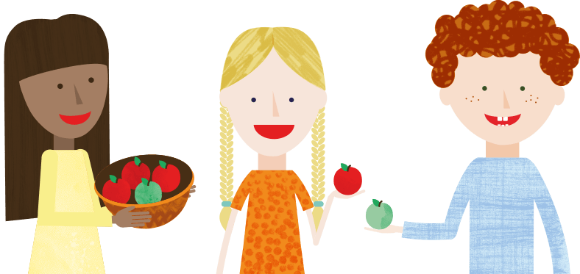
Cpa approach
Concrete – Concrete is the “doing” stage. During this stage, students use concrete objects to model problems. Unlike traditional maths teaching methods where teachers demonstrate how to solve a problem, the CPA approach brings concepts to life by allowing children to experience and handle physical (concrete) objects. With the CPA framework, every abstract concept is first introduced using physical, interactive concrete materials.
For example, if a problem involves adding pieces of fruit, children can first handle actual fruit. From there, they can progress to handling abstract counters or cubes which represent the fruit.

Slide 19
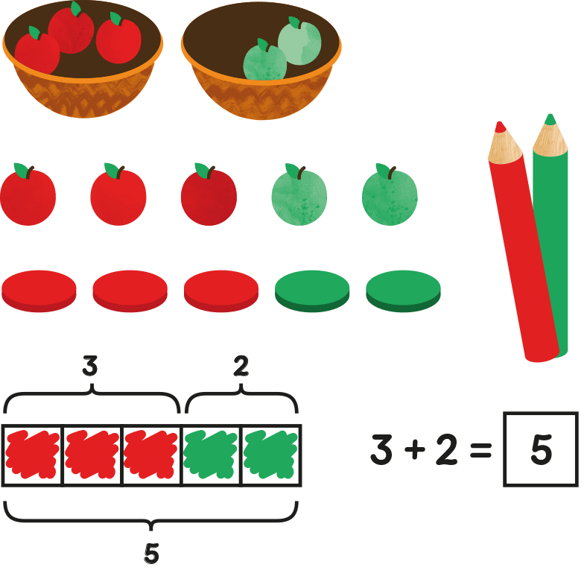
Cpa approach
Pictorial - Pictorial is the “seeing” stage. Here, visual representations of concrete objects are used to model problems. This stage encourages children to make a mental connection between the physical object they just handled and the abstract pictures, diagrams or models that represent the objects from the problem.
Building or drawing a model makes it easier for children to grasp difficult abstract concepts (for example, fractions). Simply put, it helps students visualise abstract problems and make them more accessible.

Slide 20
Cpa approach
Abstract – Abstract is the “symbolic” stage, where children use abstract symbols to model problems. Students will not progress to this stage until they have demonstrated that they have a solid understanding of the concrete and pictorial stages of the problem. The abstract stage involves the teacher introducing abstract concepts (for example, mathematical symbols). Children are introduced to the concept at a symbolic level, using only numbers, notation, and mathematical symbols (for example, +, –, x, /) to indicate addition, multiplication or division.

Slide 21
Questions

Slide 22
Approaches - Use questions carefully
Rather than saying that’s wrong ask:
My friend says……. Is she right?
Can you show me…..?
Is there another way?
Why do you think that…..?
How do you know?
What do you notice?
How is that possible?
Can you explain why that is right?
Is it true that if …..?
Can you see it? can you explain it?
Harry isn’t in today, how could we explain it to him?
Does it always work? Why?
Your friend’s might not know how you did it, can you explain?

Slide 23
Supporting different abilities

Slide 24
Questioning children to deepen their understanding
Ask have you found all the possibilities?
Make the question harder.
Can you explain your thinking?
Ask them to write their ideas down.
Seek opportunities to challenge themselves and ask their own questions.

Slide 25
Supporting children
Keep using concrete materials
Separate independent task
Other students explaining their thinking in many different ways (methods) to LA learners listening to this.
Group work/partner work.

Slide 26
How we record children’s ideas

Slide 27
How we record children’s ideas
Using concrete materials
On the screen flipchart using pictoral and abstract
On a mini white board
Taking a picture
Mirroring on the screen

Slide 28
Autumn term focus

Slide 29
Autumn term focus
Nursery
Counting
1:1 counting
Number recognition
Reception
Matching
Sorting
Comparing
Ordering
Patterning
1:1 counting
Number recognition
One more / one less

Slide 30
spring term focus
Reception
Comparing
Ordering
Addition
Subtraction
Number recognition
Nursery
Comparing
Counting
1:1 counting
Number recognition
Representing numbers using numerals, marks and fingers
Finding different ways to make a number

Slide 31
Power maths examples

Slide 32
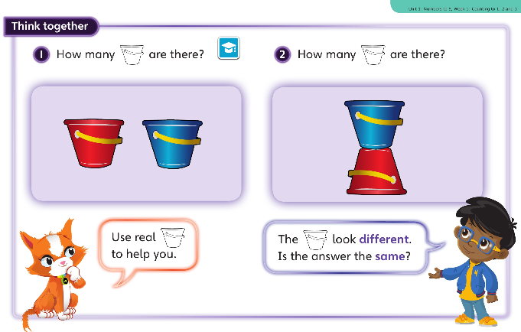
Teaching a concept using smaller numbers

Slide 33
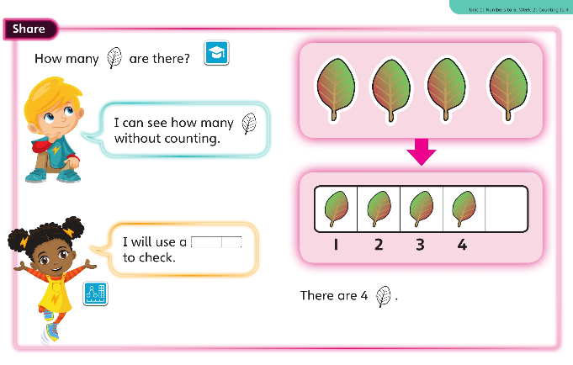
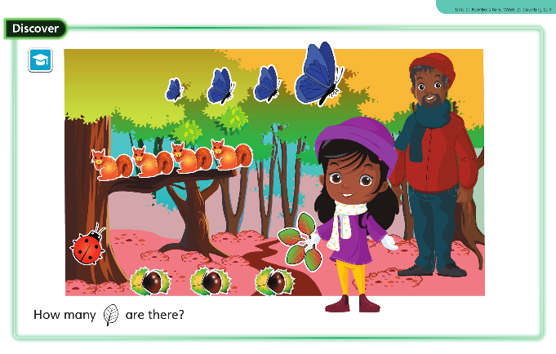
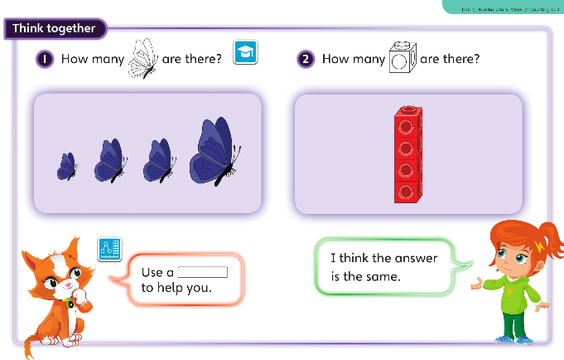
Counting to 4

Slide 34
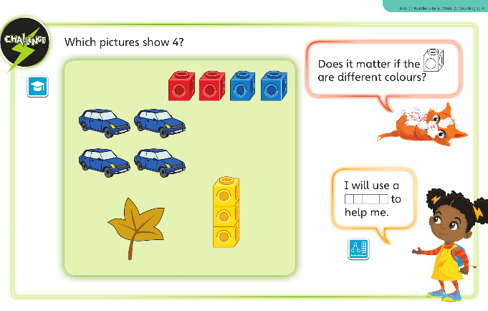
Counting to 4

Slide 35
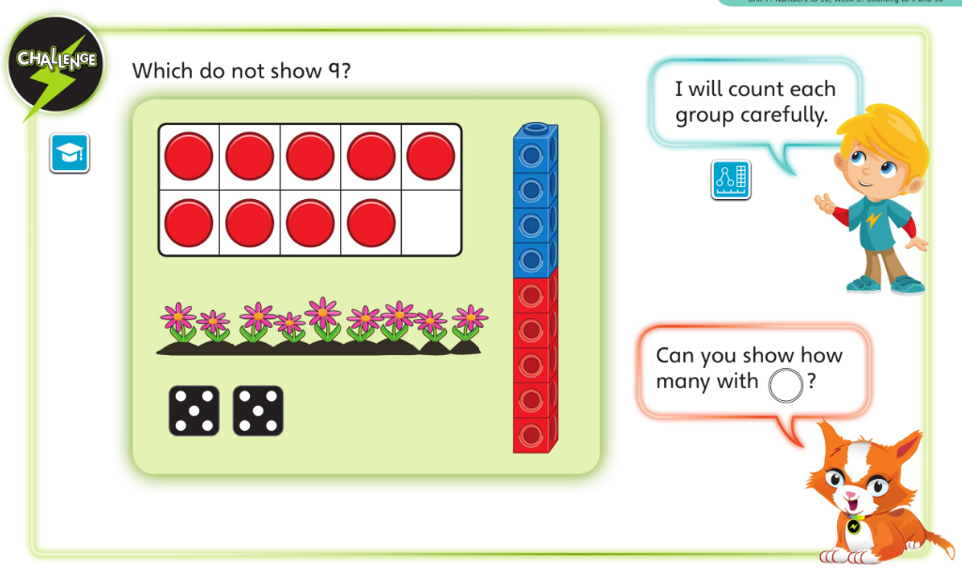
Counting to 10

Slide 36
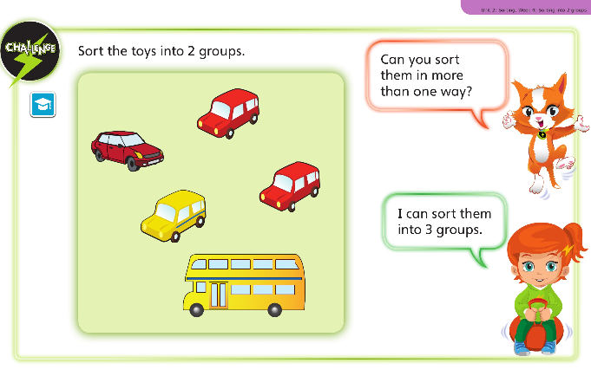
Sorting

Slide 37
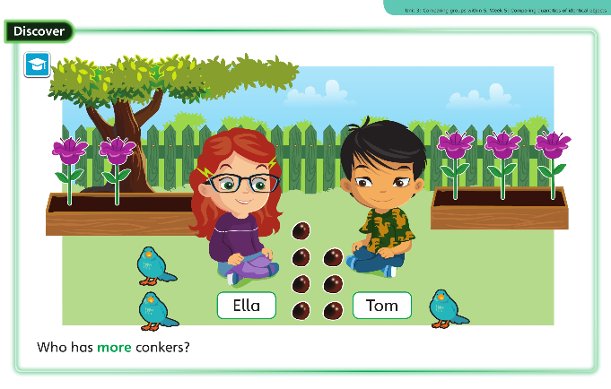
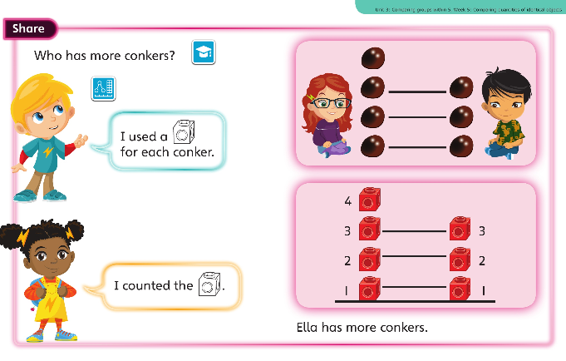
comparing

Slide 38
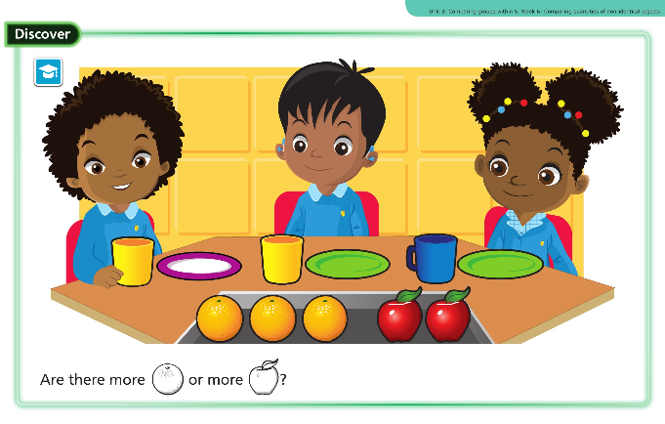
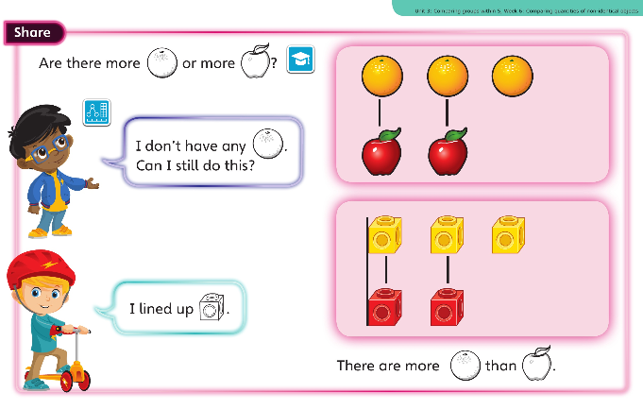
comparing

Slide 39
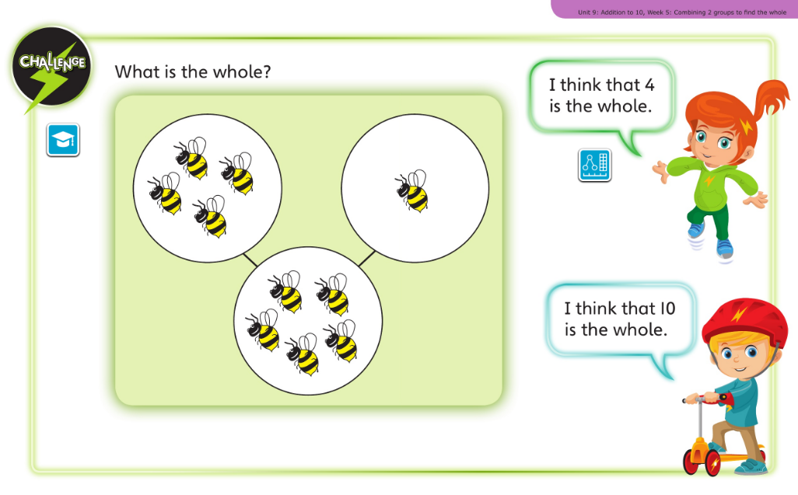
Addition to 10
Part / whole method

Slide 40
Problem solving

Slide 41
strategies
Teach children how to approach problem solving
Strategies:
Look for a pattern
Draw a picture
Make a prediction
Reason logically
Act it out

Slide 42
Who is the tallest In our class?
What will you do?

Slide 43
Show me 10
There are some shapes in the bags, the number of sides totals 10, which shapes could they be?

Slide 44
Other examples

Slide 45
When you cut a square in half you get a triangle. Is this always, sometimes or never true?
6 is bigger than 5 and smaller than 10. Can you think of another and another?

Slide 46
Which of these shapes is the odd one out?

Slide 47
Maths books

Slide 48


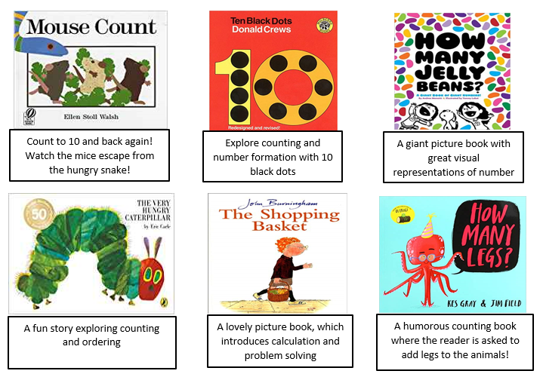
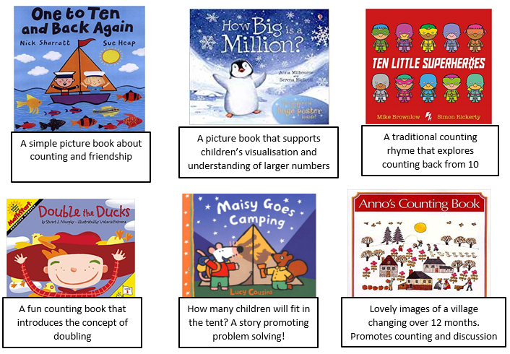

Slide 49
Thank you for coming ☺

