Slide 1

One Voice
Literacy at Torkington
Primary School

Slide 2

INTENT
At Torkington we believe literacy is a skill that enables children to develop their learning across the wider curriculum and lays the foundations for success in future lines of study and employment. We recognise the importance of taking a consistent whole school approach to the teaching of literacy.
We aim to provide children with a literacy-rich environment, high quality texts and inspiring learning opportunities, which will help them to:
Gain a life-long enjoyment of reading and books.
Read accurately, fluently and with understanding;
Apply a knowledge of structured synthetic phonics in order to decode unfamiliar words with increasing accuracy and speed;
Be able to read with expression, clarity and confidence;
Develop a good linguistic knowledge of vocabulary and grammar;
Read and respond to a wide range of different types of texts;
Develop a deeper level of emotional intelligence and empathy;
Read fluently, and with confidence, in any subject in their forthcoming secondary education.
Develop oracy skills to communicate clearly.

Slide 3
INTENT
At Torkington Primary, we want all children to be able to confidently communicate their knowledge, ideas and emotions through their writing and reach their full potential. We aim to provide children with a literacy-rich environment, high quality texts and inspiring learning opportunities, which will help them to:
Guide and nurture each individual on their own personal journeys to becoming successful writers.
Provide exciting writing opportunities and experiences that engage and enhance all pupils.
We want all children to acquire a wide vocabulary and to be able to spell new words by effectively applying the spelling patterns and rules they learn throughout their time in primary school.
We want all children to have a solid understanding of grammar and apply it effectively to their writing.
We want them to write clearly, accurately and coherently, adapting their language and style in and for a range of contexts, purposes and audiences.
We believe that all children should be encouraged to take pride in the presentation of their writing, in part by developing a legible, cursive, individual handwriting style by the time they move to secondary school.
We want every child to have a good knowledge of phonics to springboard children to becoming fluent writers.
To plan a progressive curriculum to build upon previous teaching, with regular assessment to ensure each child’s needs are met to reach their full potential.

Slide 4

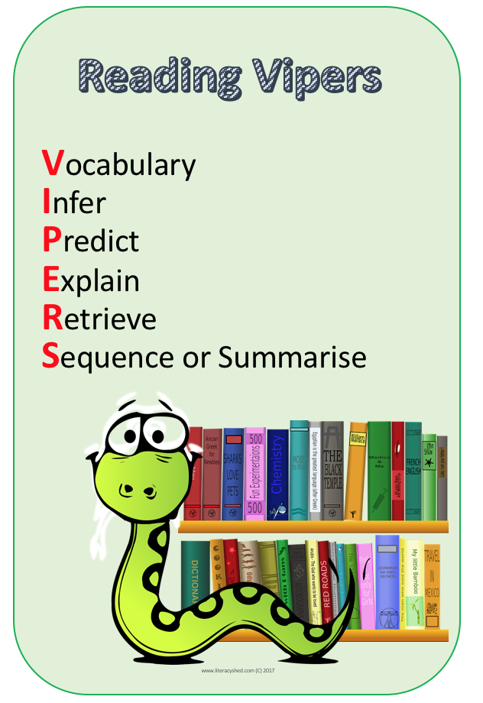
IMPLEMENTATION
Language comprehension
At Torkington, children study reading daily using VIPERS. This ensures that we use the correct Lexile level for the children to access the comprehension independently. The VIPERS skills enable the children to understand what the question is asking and give them the correct tools to answer. High quality texts and passages are chosen, appropriate to the expectations of the year group or ability of children, and teachers use this to model the application of the agreed reading skills. We ensure that once a half term the children have a week focused on poetry and different poets. In EYFS we have daily stories time and rhyme sessions and discuss questions related to the stories. This is where the children can talk about the story of the week and have an activity linked to their book.

Slide 5
IMPLEMENTATION
Language comprehension
At Torkington, children have a daily word of the week. This is chosen through the texts they are reading. It is to develop their understanding of tier 2 words within their writing and contextualise vocabulary within class texts. In EYFS and KS1 the words are displayed and referred back to on the working wall. In KS2 they are displayed and referred back to on the working wall and the children have ownership over their own vocabulary books. These books are use as a writing tool so children can reference previous words from their own reading or the words that have been discussed within literacy and reading sessions.

Slide 6
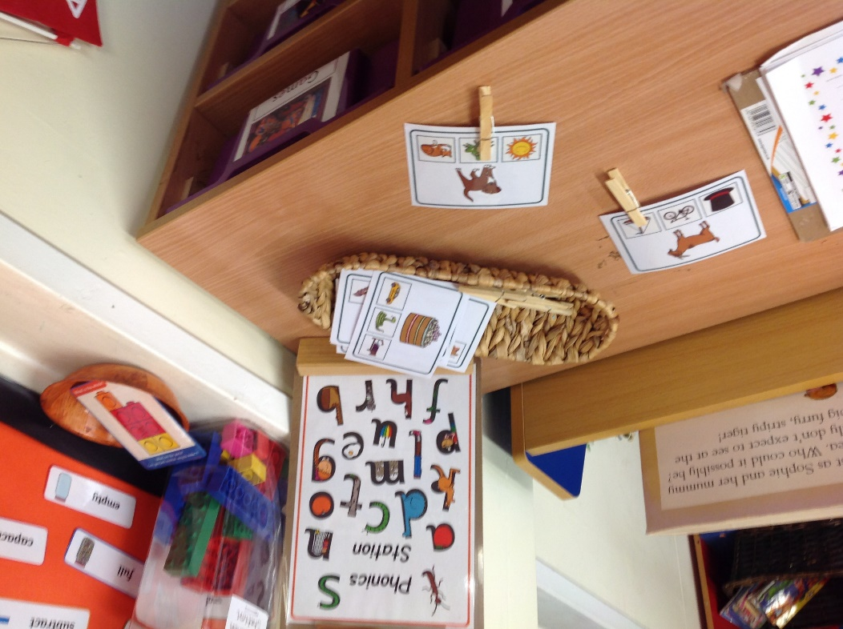
IMPLEMENTATION
Word Reading and Spelling
Alongside reading in EYFS and KS1 we use the synthetic phonics Super Sonic Phonic Friends to deliver the teaching of phonics. The children follow a reading scheme which is at assessed through their phonics levels. In EYFS and KS1 parents readers volunteer listening to children read their decodable phonics books. As well as children being read with by teachers and teaching assistants to assess their level. We have developed the use of phonics jotters to build letter formation and sentence structure. All of the Year 3 children progress onto the Nelson spellings. Children that need extra support are targeted through the Intervention.

Slide 7
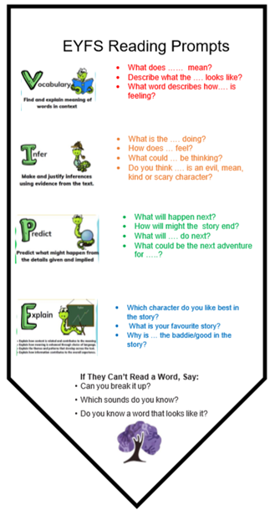
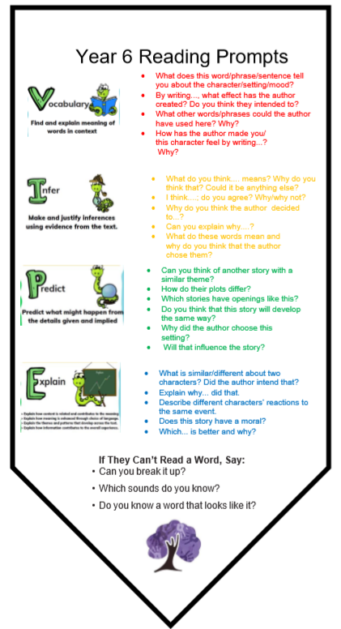
IMPLEMENTATION
Reading for Pleasure
At Torkington, we believe that alongside their children’s reading scheme books it is important that we have daily story time sessions. This is when the teacher will read to the children and modelled reading with intonation, expression and confidence. The stories are chosen by the teacher and shared with the children. We also have a star author every half term to develop children’s knowledge of stories and read a variety of different texts.
World Book day
For world book day we shared stories of protected
rights authors. We enjoyed reading stories, sharing facts about
the authors and creative artwork based on the books.

Slide 8
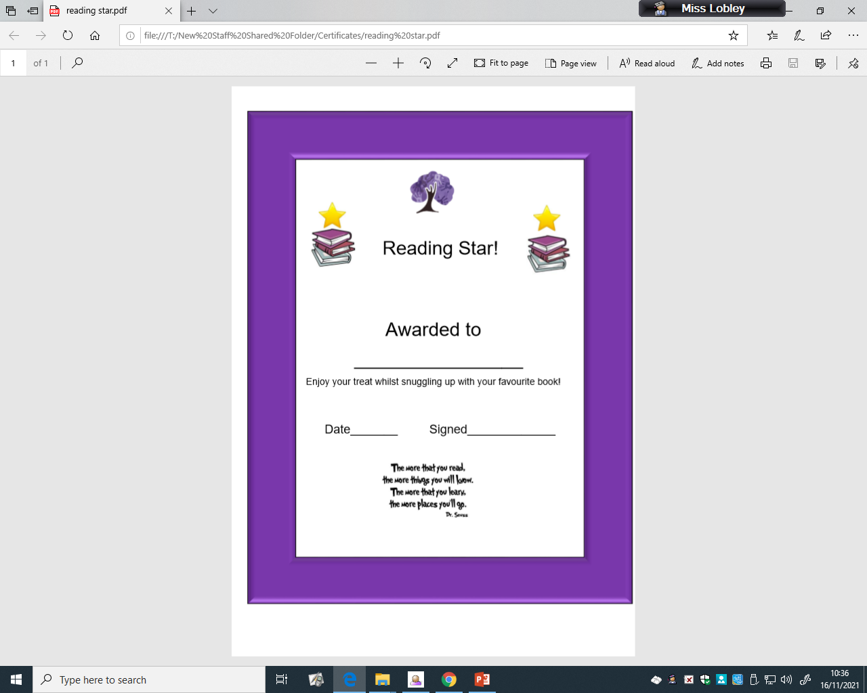
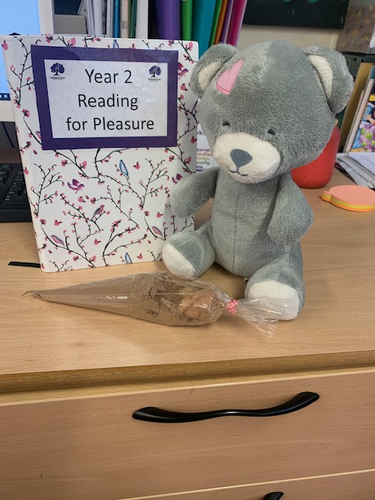
IMPLEMENTATION
Reading Pleasure
Throughout the school for 15 minutes at the end of the day we have reading buddies where the older children will read with the younger children either in the library or in the classroom with their decodable phonics book.
Every week we have a reading star of the week. This is celebrated in assembly and the reading star takes home the class reading pet and hot chocolate. The following week the story they chose is shared to the class and kept in a class reading journal.
Children across school take part in the book awards. Our learning council took ownership of a reading audit to choose our Torkington reader of the year. They were then invited to a ceremony celebrating readers. Part of this included author visits from the various awarding winning authors.

Slide 9
IMPLEMENTATION
At Torkington, writing is taught 4x per week across the whole school. Each class studies a different high-quality text, lasting from a few weeks to a whole term depending on text type, length and year group. We passionately believe that reading and writing are inextricably linked therefore studying the text in both reading and writing sessions encourages children to make links and become empathetic and ambitious writers.
Long, medium and short term planning and the use of progression maps ensure that a variety of genres are progressively taught and built upon both throughout the year and throughout the school.
Writing is also a key focus in the wider curriculum, especially in Humanity lessons. Children are given the opportunity to transfer and build upon their knowledge of a genre studied during English lessons and apply this learning to a topic focus.
Through the ‘differentiated texts’ writing process, children will acquire and learn the skills to plan, draft and refine their written work over time and are encouraged to develop independence in being able to identify their own areas for improvement in all pieces of writing.
Within each unit of work, sequenced lessons ensure that prior learning is checked and built upon and that National Curriculum objectives are taught through a combination of approaches/opportunities
At the end of the writing unit a child will complete a hot task this ensure they can reflect on their progress and this piece is used as an assessment piece as an independent write.

Slide 10
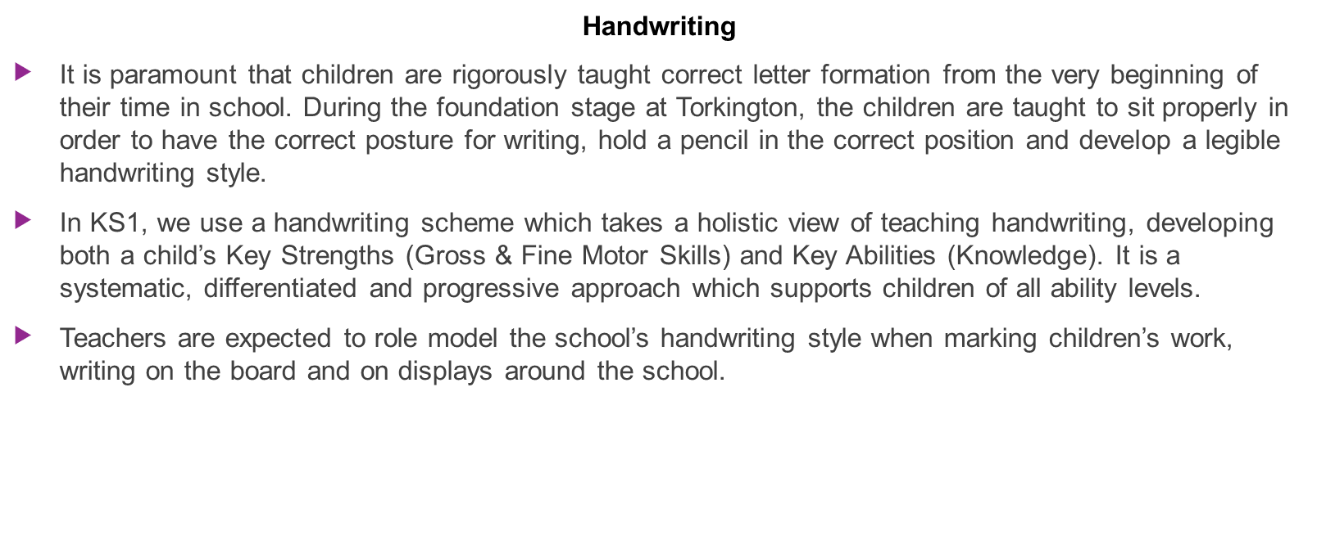

Slide 11
IMPLEMENTATION
Spellings
From Year 1, classes follow a progressive spelling scheme. Through exploring spelling patterns and rules, we aim to create confident and proficient spellers using a discrete teaching approach underpinned by phonics.
Children are also taught to
Spell accurately and identify reasons for mis-spellings.
Proof-read their spellings
Recognise and use word origins, families and roots to build their skills
Use dictionaries and thesauruses.
Vocabulary books used to support the teaching of new words.

Slide 12
IMPACT
As a result of our Literacy teaching at Torkington you will see:
Fluent and confident readers.
Children who can share opinions about stories and authors.
Children who can read books to enhance their knowledge and understanding of all subjects on the curriculum, and communicate their research to a wider audience.
Children who can eloquently discuss questions surrounding reading.

Slide 13
IMPACT
Constructive marking with ‘next steps’ and ‘modelling’ where appropriate. Teachers leave next steps in books when marking to ensure that children. After a hot task in Ks2 children are encourage to set their own next step and in KS1 in discussion with the teacher.
The impact on our children is that they have the knowledge and skills to be able to write successfully for a purpose and audience.
Children who are more confident writers and have the ability to plan, draft and edit their own work.
Children who are confident at speaking and listening.
Children who can clear communicate their ideas in learning discussions.

Slide 14
Learning that is tracked and monitored to ensure all children make good progress.
IMPACT
Timely Interventions:
Teachers believe that all children can achieve in reading , and focus on whole class teaching.
Where prerequisites are not secure, timely interventions will be carried out. Our interventions are focus using the simply view of reading pedagogy. The class teacher and teaching assistant will assess the child to unpick what part of reading the child is struggling with. An intervention will be put in place to address either decoding skills or comprehension skills. Across the school the most vulnerable readers are identified and are read aloud with minimum of twice a week to build up confidence and fluency.
Formative Assessments:
Children are continually monitored through guided read when they independent answer questions. They have trackers in their book which identify when the skill has been taught as a reference to the teacher. Summative assessments are conducted half termly and question analysis is use to identify class/individual strengths and class/individual weakness. This will inform the class teacher which intervention need to put into place to make the expected progress.

