Slide 1
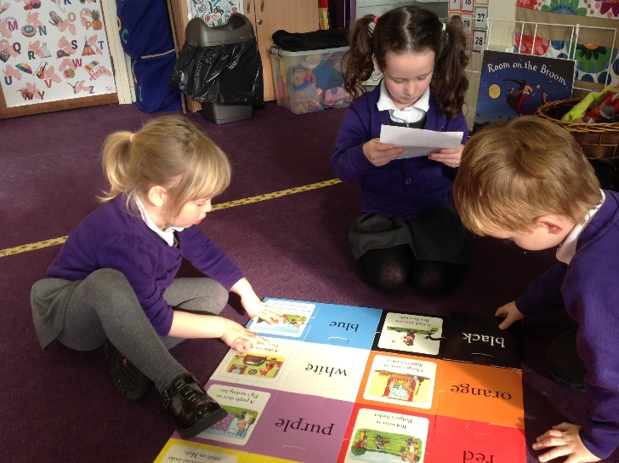
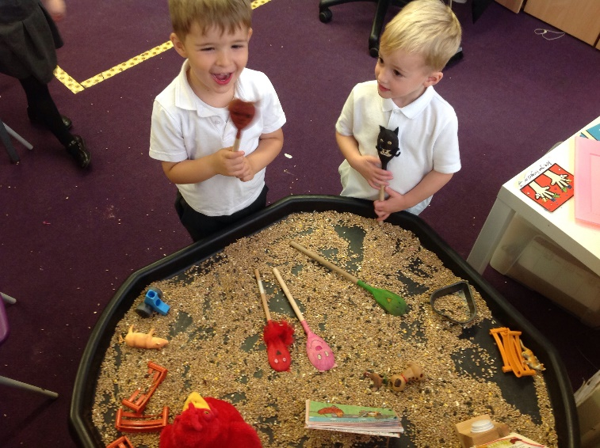
One Voice
EYFS communication
and language at Torkington
Primary School

Slide 2
INTENT
Communication and language is the most important tool in a child’s toolbox. Without it children would be unable to successfully access and achieve in all areas of the EYFS curriculum. During EYFS communication and language is at the forefront of our practice through a language rich environment. We encourage and support children to find their own talking voices so that they have the opportunity to share their ideas and reach their potential. As well as a language rich environment we provide the children with fun, engaging and exciting learning opportunities where children are eager to join in, take ownership of their learning and provide them with a voice to express themselves with confidence.

Slide 3
IMPLEMENTATION
Communication and language is probably one of the only areas that is practiced constantly through out the day and this is most probably why it’s a prime area along with PD and PSED. Talk is vital in being able to achieve most of the 17 areas of the EYFS curriculum. Through talking children not only build foundations for learning but for life too. They learn how to interact and communicate and function as part of a class and a school community.
All areas of the EYFS classroom pose opportunities to promote and develop children’s communication and language, especially outside where the continuous provision is completely child led. Other areas include Phonics, role-play and small world. Through these areas children use talk to express and organise themselves interacting and playing with their peers. Communication starts with listening so we make sure we have a language rich curriculum where we take the time to explore talk giving children plenty of opportunities to just listen first, especially in Phase 1 Phonics. Children need to tune their ears in first and then the expectation can be for children to respond at their own pace. We have fun with songs with an emphasis on Nursery rhymes as research has suggested if children know 8 songs by the time they are 4, by the time they are 8 they will be one of the best readers and spellers in the class. Talk simply is the foundation for the EYFS curriculum. Play, chat, read is our EYFS moto!
At Torkington children are encouraged to communicate in their own way with no pressure or expectations as to what the right way is as all children learn in different ways at different paces. Children are listened to and given the chance to process before being expected to respond. We have children who are eager to share their ideas and talk about the world around them when they exit EYFS.

Slide 4
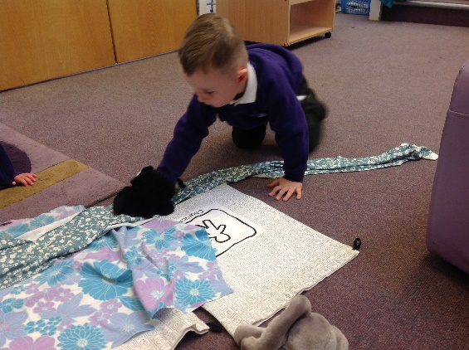
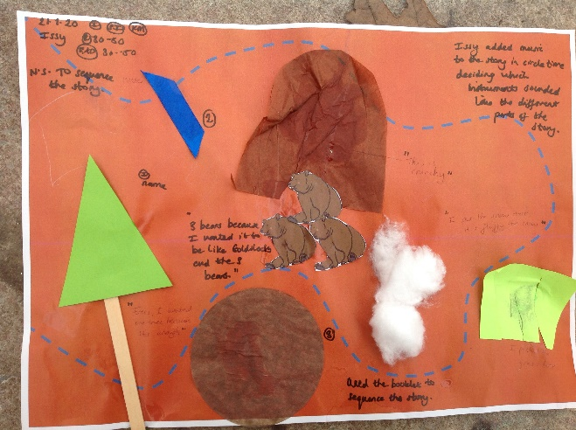
IMPLEMENTATION
At Torkington as well as quality first teaching we have invested in tales toolkit. Tales toolkit enhances children’s ability to create stories using their own ideas and encourages them to use their imagination with an emphasis on extending their vocabulary. All of the resources are labelled with easily recognised symbols for Character, Setting, Problem, Solution giving the children a tool to independently weave magical tales. Tales Toolkit makes a difference where it matters, early on, setting children up for later success. Tales Toolkit develops many areas of learning, skills and characteristics of effective learning including language, literacy, social skills, creativity, confidence, empathy, boys writing, problem solving, maths and lots more. It also enhances the learning of familiar stories giving children a familiar structure so that they can discuss stories they love.
All staff are trained in tales toolkit and it is delivered weekly as a class circle time by teachers and TA’s with opportunities to explore stories further in the independent areas. We also use it for communication and language and self confidence interventions.

Slide 5
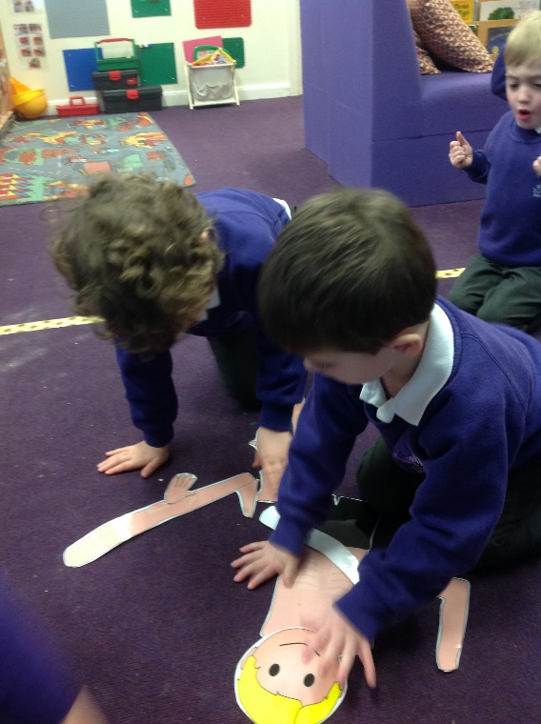
IMPLEMENTATION
Another tool we use for communication and language is Wellcomm. Wellcomm is a complete speech and language toolkit that supports children all the way through EYFS. It is used mainly to promote understanding identifying gaps and through quality first teaching and interventions addresses these as it picks up on class misconceptions that may need to be addressed in circle time e.g. positional language, use of because, correct use of gender terms, size language.
Lots of aspects of wellcomm are natural to us, for example when we read a book we ask who, what, where and when questions instinctively. Using wellcomm as a assessment tool highlights any gaps and supports daily interactions furthering children’s progress in communicating.

Slide 6
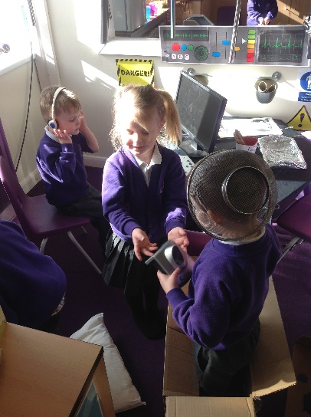
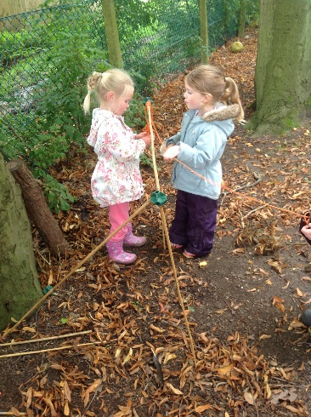
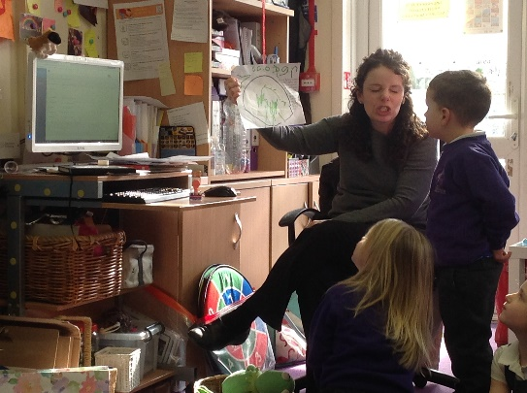
Impact
As a result of our quality first teaching in communication and language at Torkington you will see children are confident learners PSED and CL. Children know that they are listened to and enjoy sharing their ideas with others in a safe space. As a school we know how powerful talk is from our learning council and that it is key to some of our successes as a school. Children are vocal about their learning and the world around them, they show confidence in themselves and their learning which their experiences in EYFS created the building bricks for. Pupil voice opportunities provide them with the chance to share their experiences and shape their learning. Listening, attention and understanding as well as speaking are among the highest achieving areas on exit from EYFS and this is no surprise with the amount of emphasis placed upon them in the first vital years of a child’s education. All staff are aware that it is a prime area and place a huge emphasis on communication. A child’s ability to listen and understand directly impacts on their ability to learn in EYFS and as they continue further in their school life, as mentioned previously it is one of the most important tools in a children’s toolbox for effective learning. Walk around our unit and in every direction there will be talk that is purposeful for learning and communicating.
Wellcomm as an assessment tool picks up on gaps in children’s communication and addresses these through a series of activities delivered to the class or small group, it identifies misconceptions that may otherwise may be taken for granted children should know but as a school we have found that the gaps in communication and language continue to become more apparent and with COVID children may not have had the opportunities for interaction they would otherwise have had prior to entering our setting and so we expect to continue to find gaps in this area in the years to come as the true effects of isolation early on in a child’s life come to light.

Slide 7
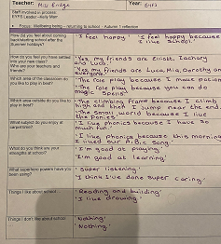
Impact – pupil voice
After the first half term at school children were asked to reflect on returning to school, their ability to articulate their ideas was impressive as well as their ability listening to the adult and understand the questions they were being asked.

Slide 8
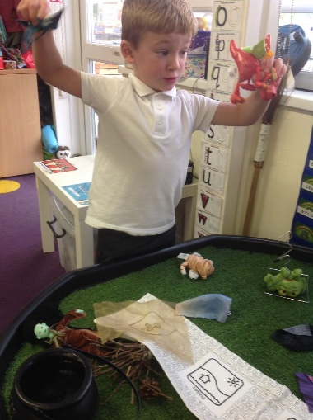
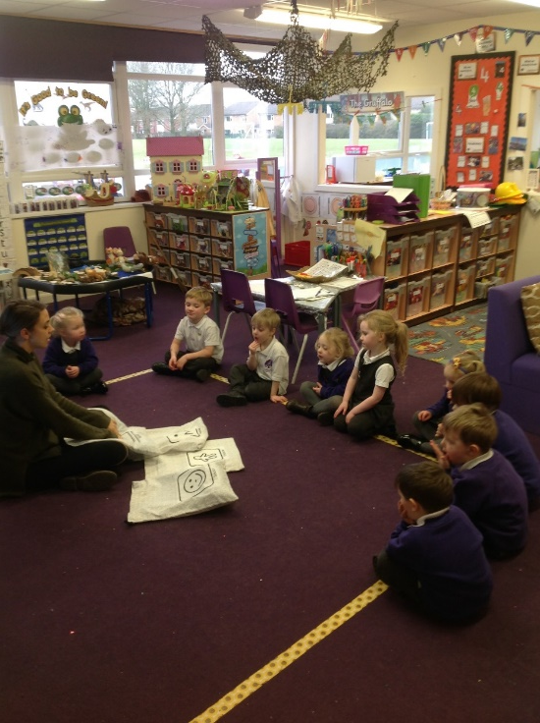
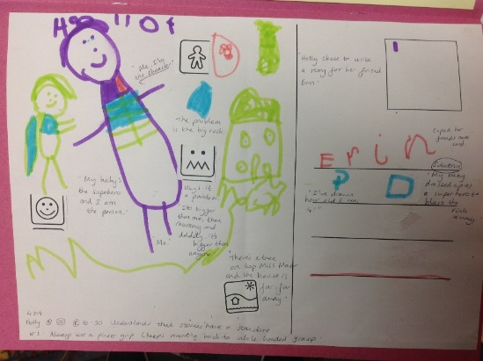
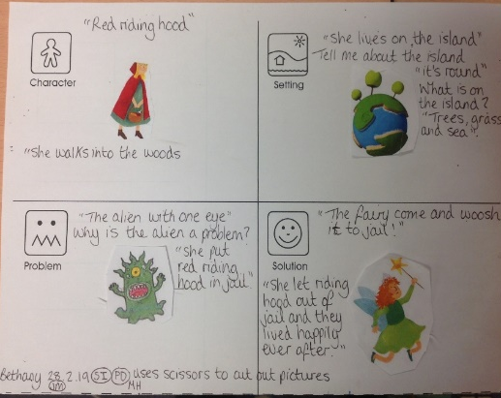
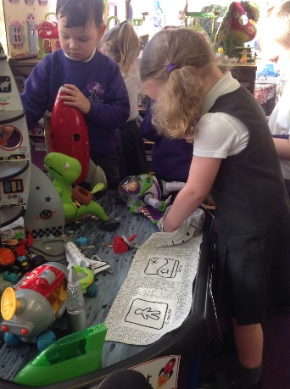
Impact - Why we choose tales toolkit
We have found Tales Toolkit to be fun and engaging for both children and staff. Children work at different levels and with different needs but are all involved and learning. Children lead the stories following their interests and create interactive stories with their peers showing co-operation and collaboration. It has also promoted independence and imagination as there is no prescriptive ideas of what stories our children will create, the possibilities are endless and unknown. This has been evident through our observations of children in the areas, recorded video’s on early essence and children’s recordings using the tales toolkit post cards.
Nursery have especially seen the effect having a simple story structure has had on reading. We have found that this has impacted on children listening to the longer stories we create together remembering much of what happens and the order in which the events occur. We also added the symbols to children’s reading books so they became familiar with these and started to use the language in their independent reading, discussing the stories and demonstrating their comprehension skills.

Slide 9
Next Steps:
Growth mindset– Whole School Initiative
Our school Growth Mindset Culture fosters a positive attitude towards learning supporting children to make good progress and be successful throughout their school lives. This all starts in EYFS where they are introduced each week to a one of our Growth Mindset words and this is then explored throughout the week with the children. This has become a key priority for the school as we’ve proven it’s success in previous years. This needs to be embedded in our everyday language through our teaching and verbal and written feedback and celebrated in our weekly happy assembly.
Tales Toolkit symbols.
To look through recently purchased books, ensuring that they are equipped with our Tales Toolkit symbols. This would support the children's use of the language in their home environments. Parents will also be offered the opportunity to watch a Tales Toolkit workshop video and an online lesson to support them with telling Tales Toolkit stories at home. Symbols could also be visible in the Library to provide children the opportunity to discuss with their reading buddies.
Tales Toolkit Bags.
Purchase or create extra Tales Toolkit bags to be shared across the three classes currently using the scheme. Also a set could be made to live in our outdoor small world area to promote outdoor story telling.
Outdoor Area.
A commitment to research and purchase outdoor resources and equipment to enhance our small world area, making it more inspiring. Opportunities for children to plan for the area by selecting resources that follow their interest and therefore allow children the power to take ownership of their own learning.
CPD
A commitment to gain knowledge through CPD to understand the role of a speech and language specialist. Research ideas and activities that would help develop communication in those children struggling with sound clusters, irregular tenses and plurals.

